Slide 1
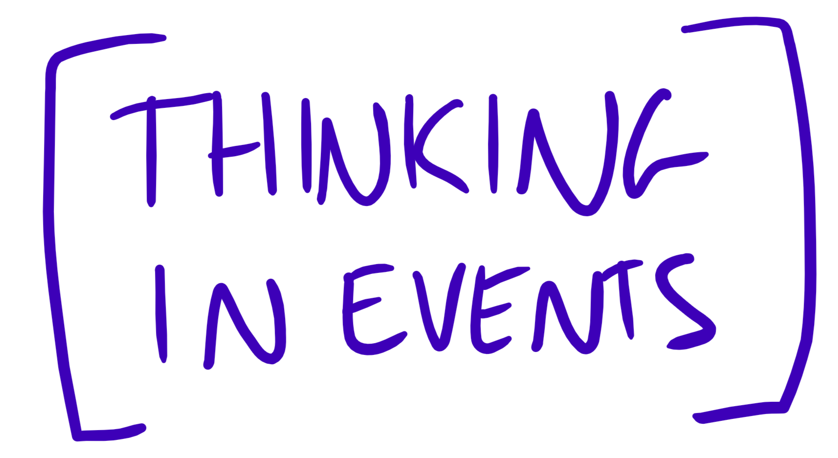
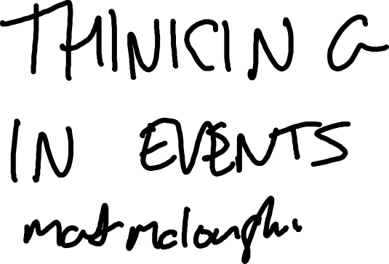
Notes:
Originally going to talk about 2nd hand car sales but that’s too crooked an industry
1

Slide 2
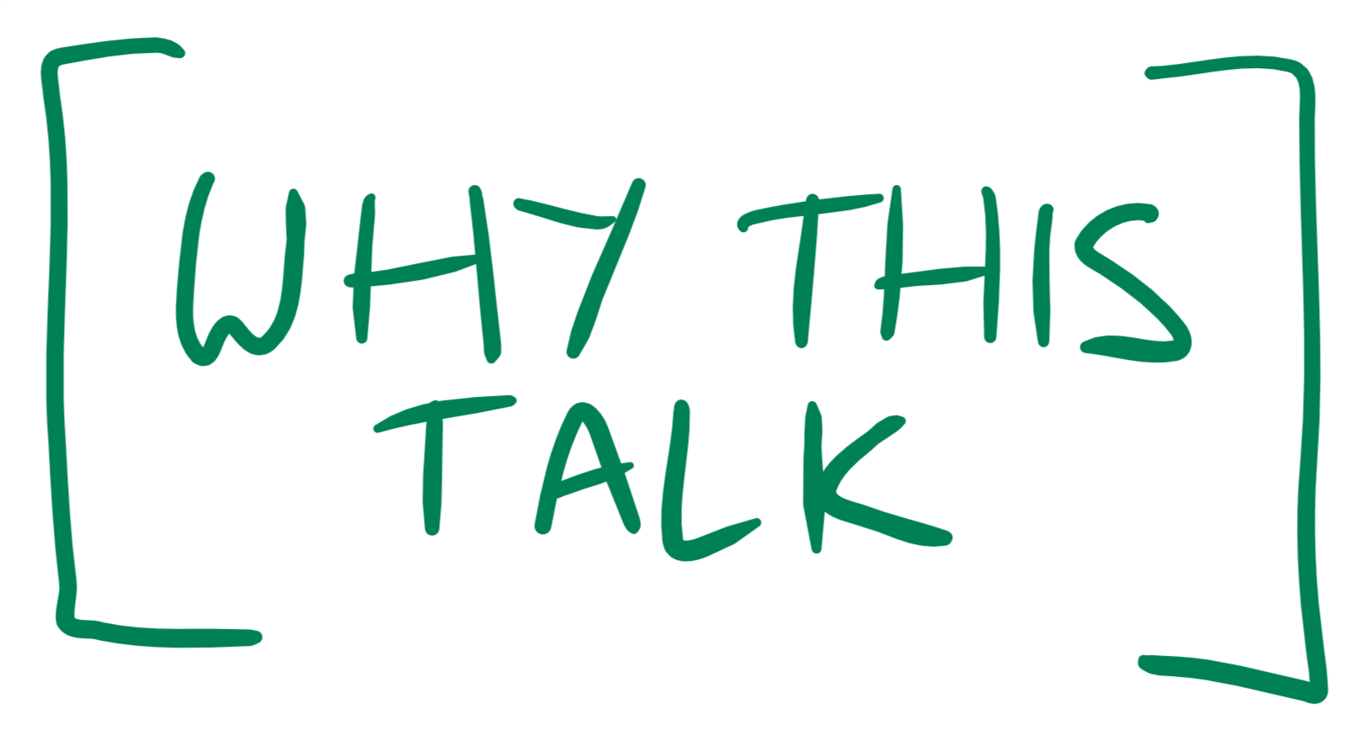

Notes:
I’ve been working in DDD
And within DDD there is this concept of an event, specifically a domain event
And this idea of an event is so clever and so simple
And its really useful for helping you to design your applications and for your you build it to
2

Slide 3
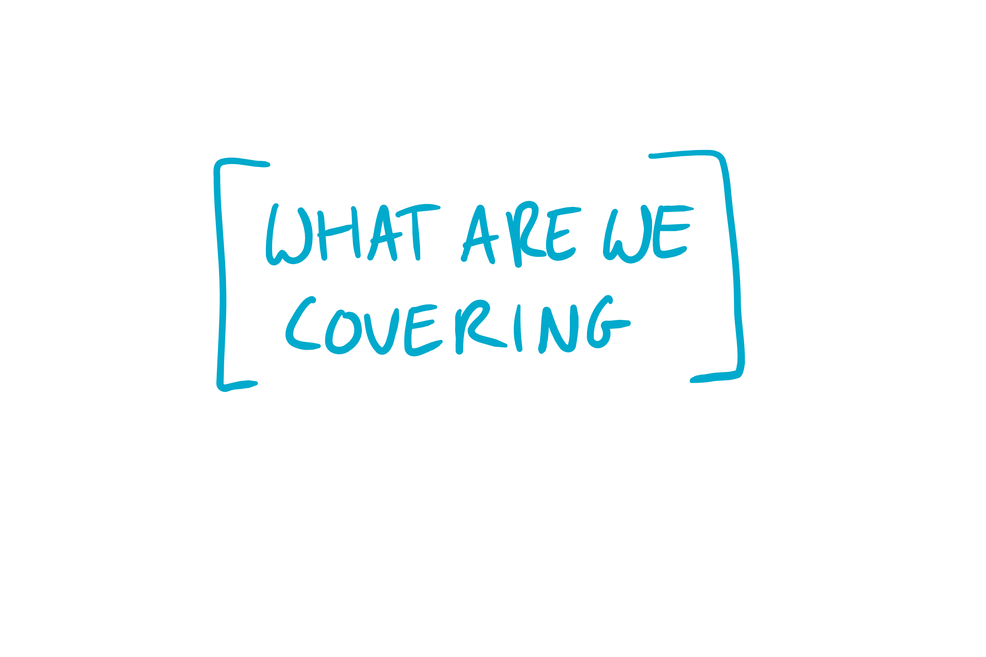

Notes:
About how events can help you design and figure out your domain
How they can help change the way you write code
Then just talk about some other advantages events can bring to your application
3

Slide 4
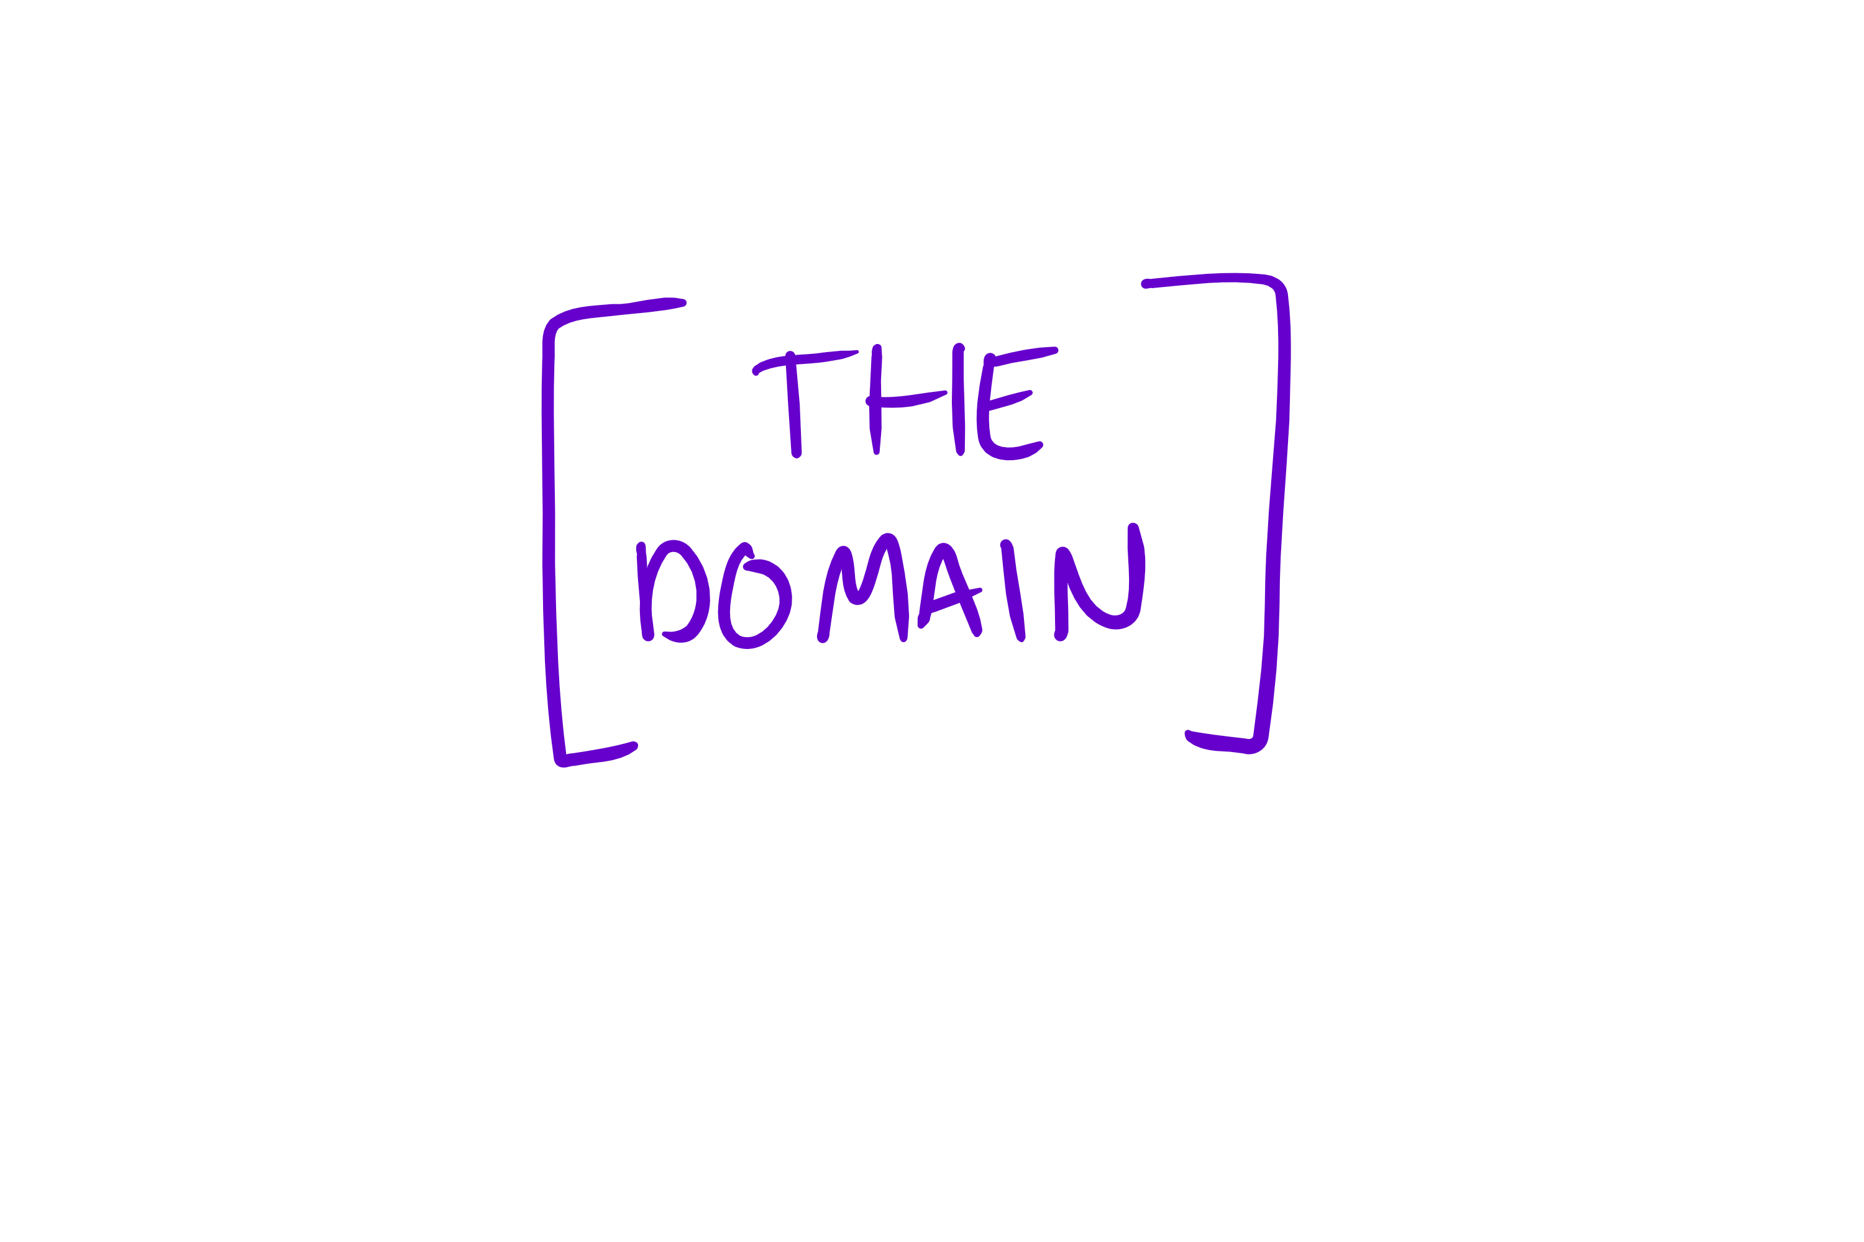
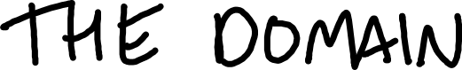
Notes:
So lets start by talking about where I see a problem in the way we design and build application
Imagine this scenario
4

Slide 5




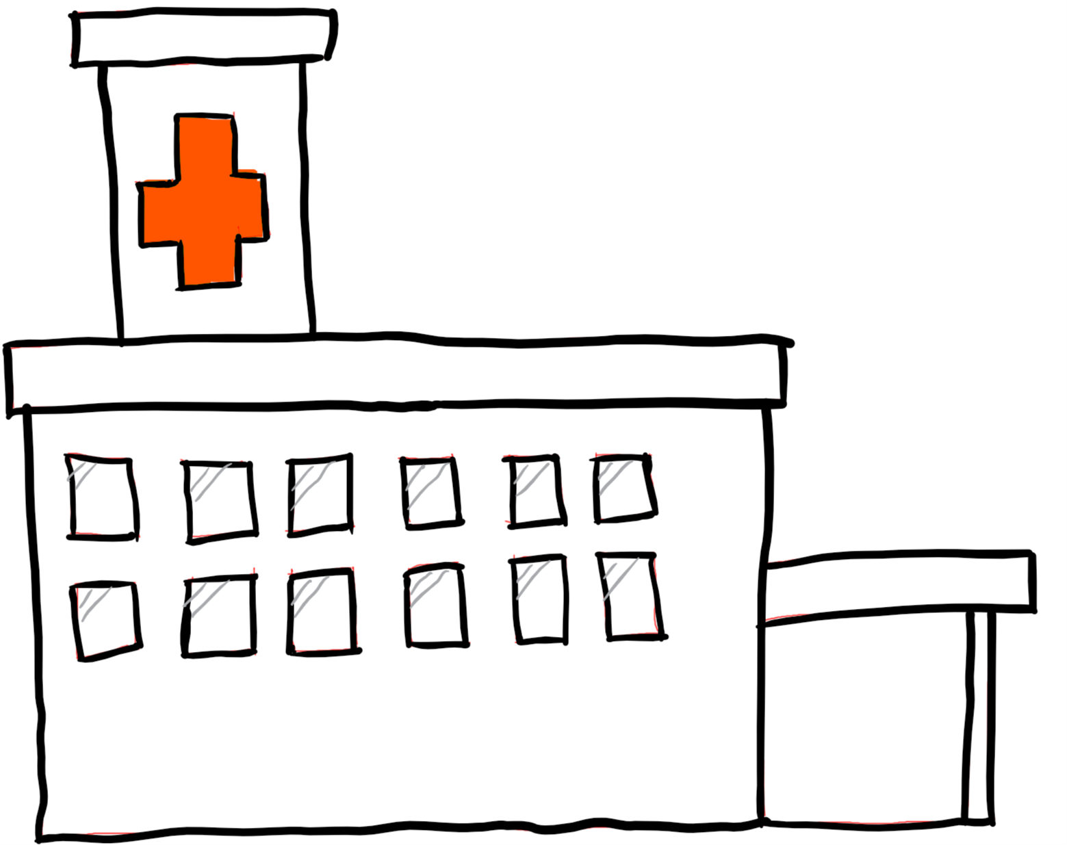

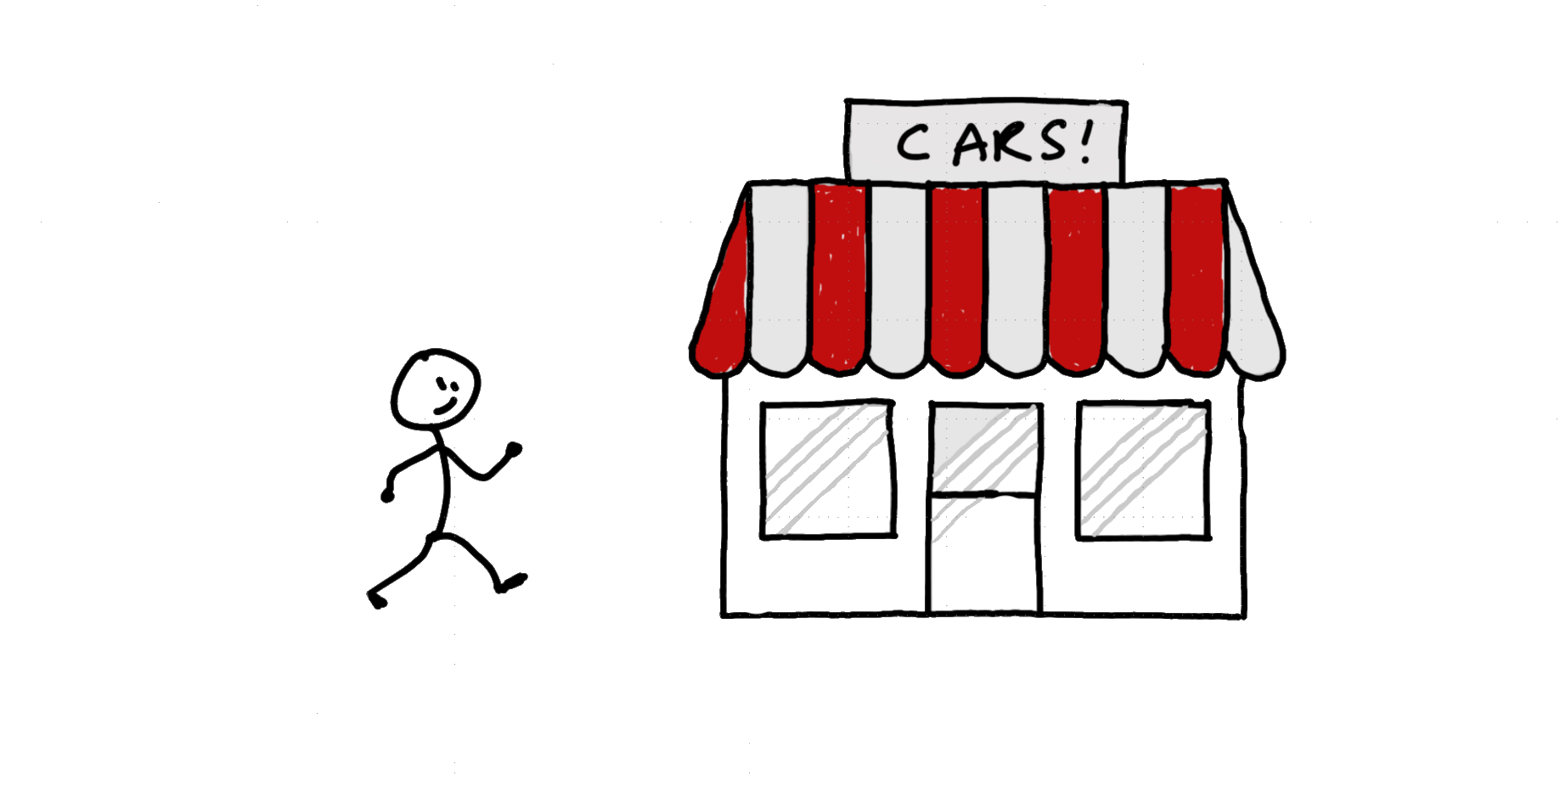

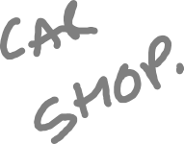
Notes:
Goes to hostpital because he’s not well
5

Slide 6

Notes:
Gets admitted. And when they get admitted this fact needs to be recorded in some software
6

Slide 7
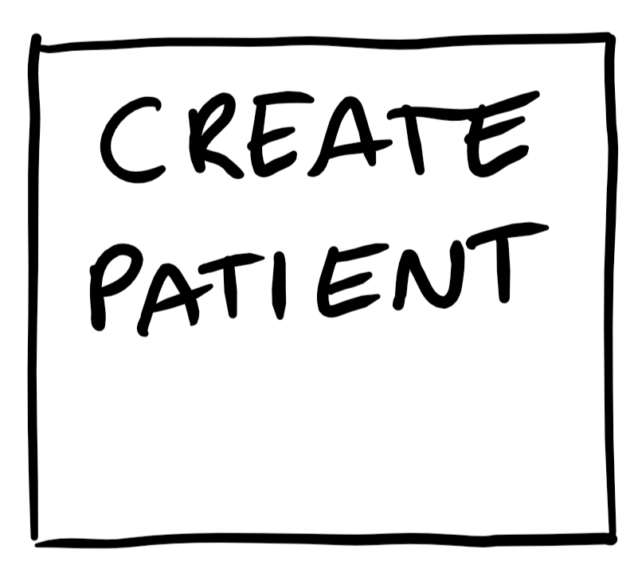

Slide 8







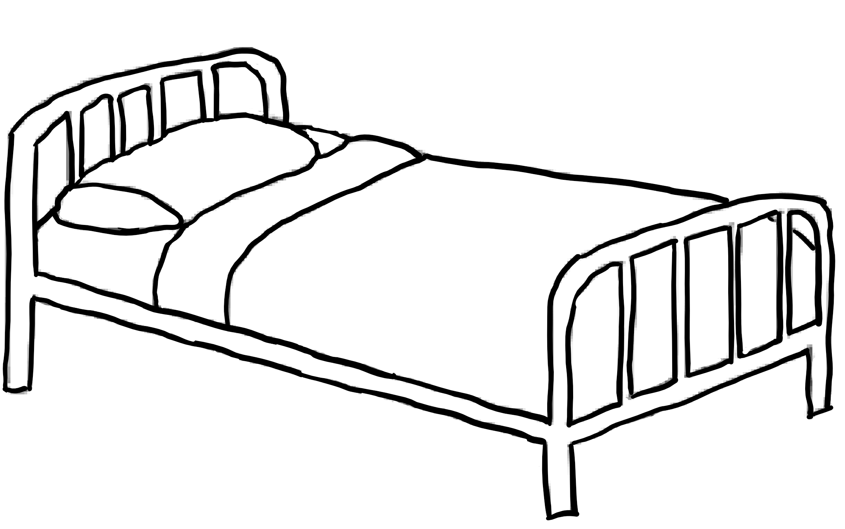

Notes:
And at this point we again need to go to the software and update the patient record again
8

Slide 9
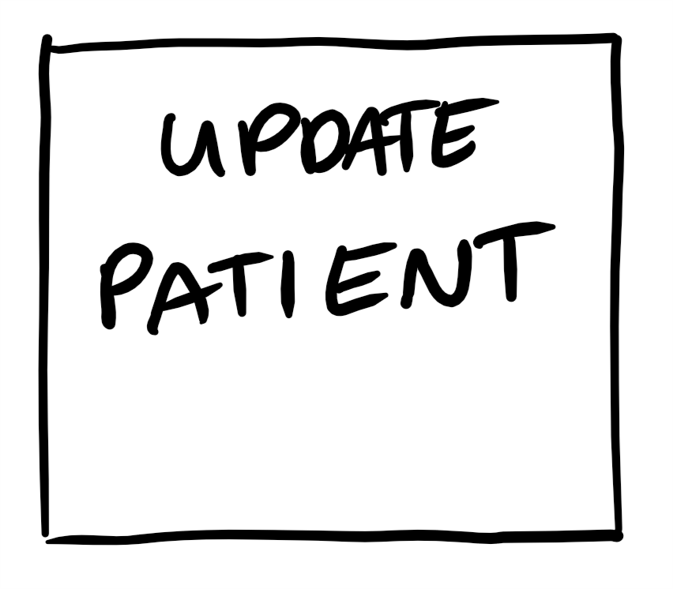

Slide 10
Notes:
Imagine the scenEio
10

Slide 11
Notes:
Now, not only does things this way end up in us writing some spectuclarly ugly code trying to cram all out logic into a method or two
But its not how people think
11

Slide 12
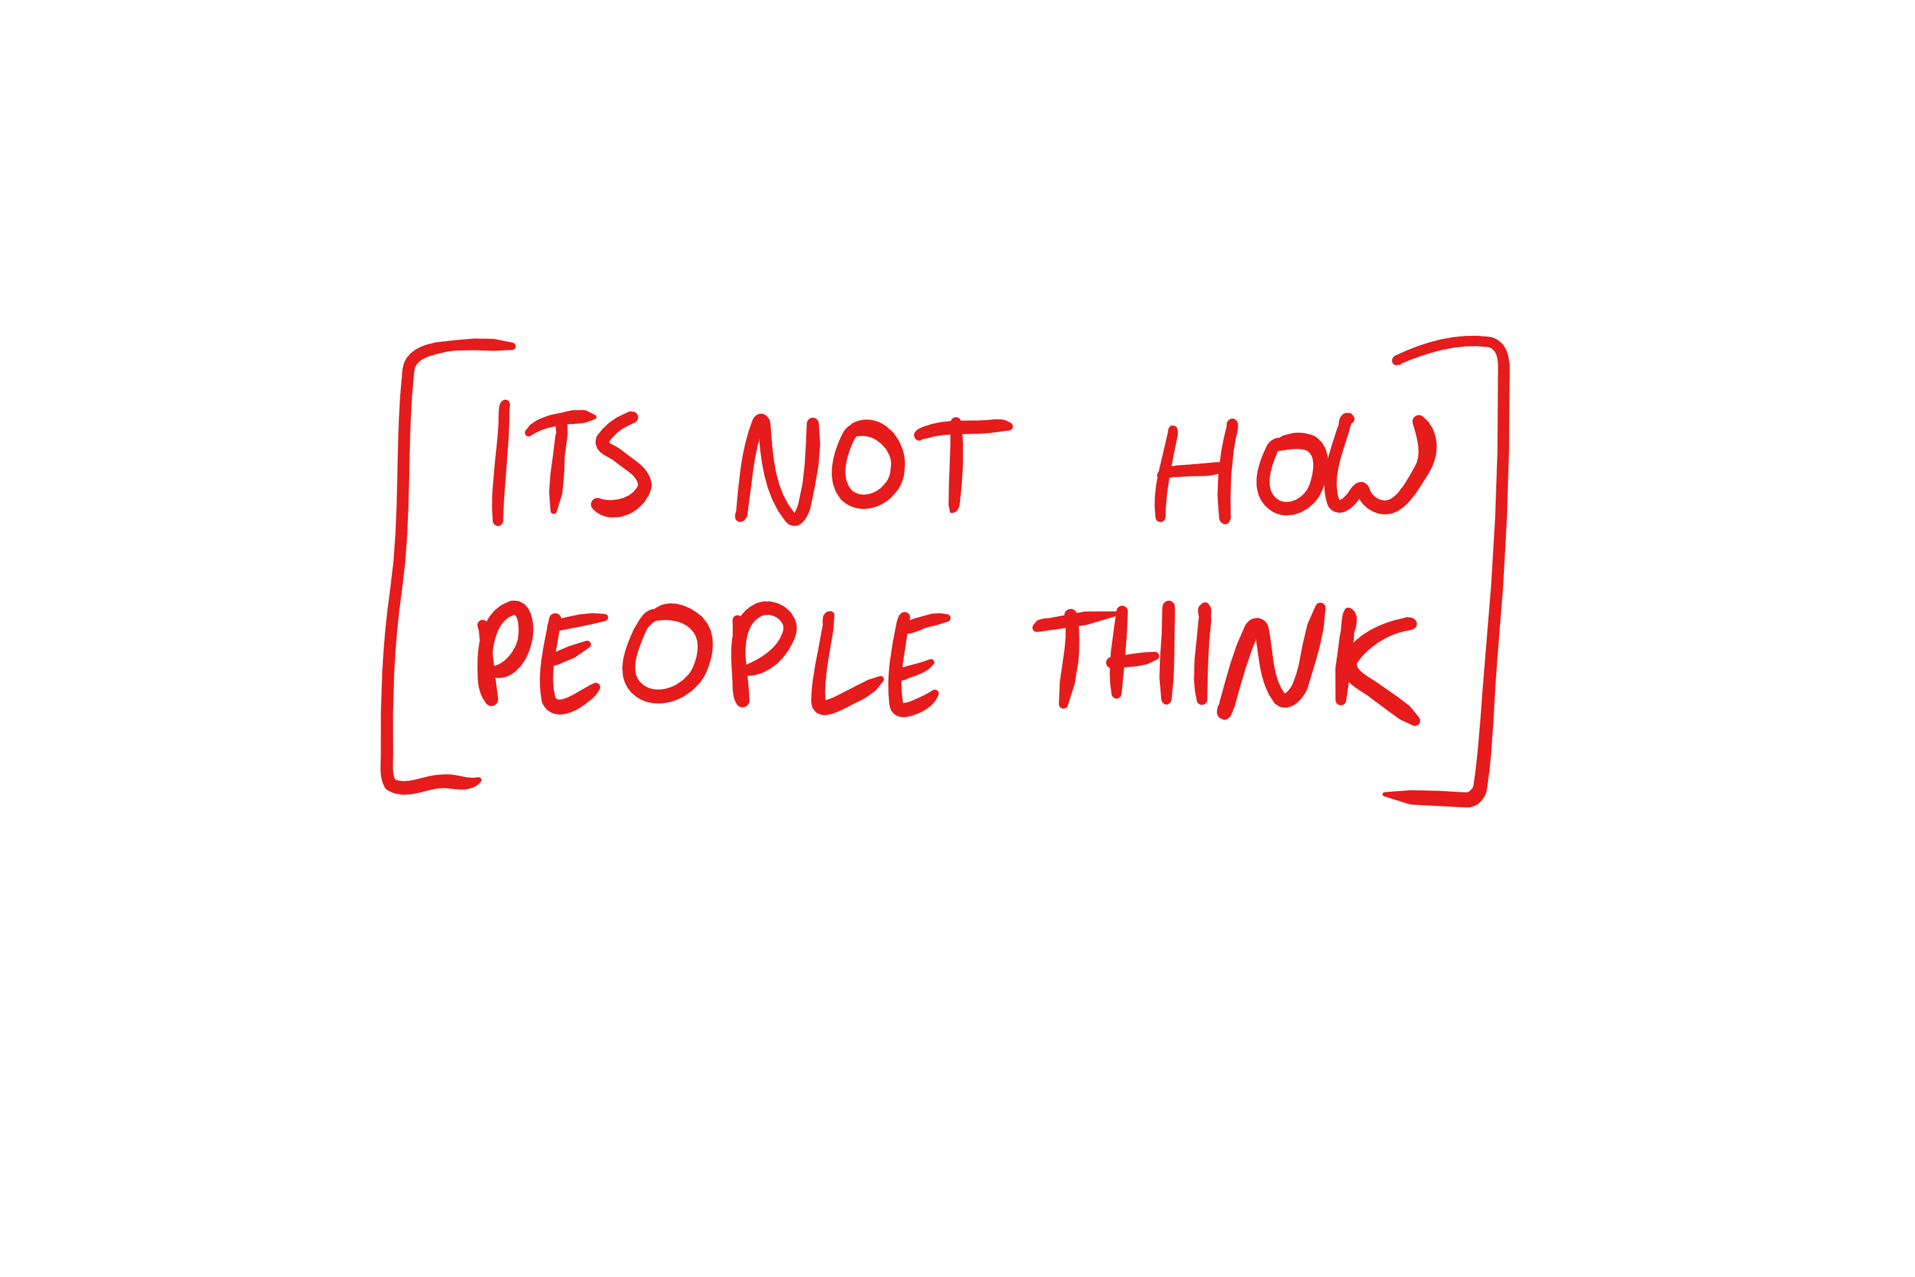
Notes:
What we do as software developers is we constantly try and take these real world events and convert them into update statements
12

Slide 13
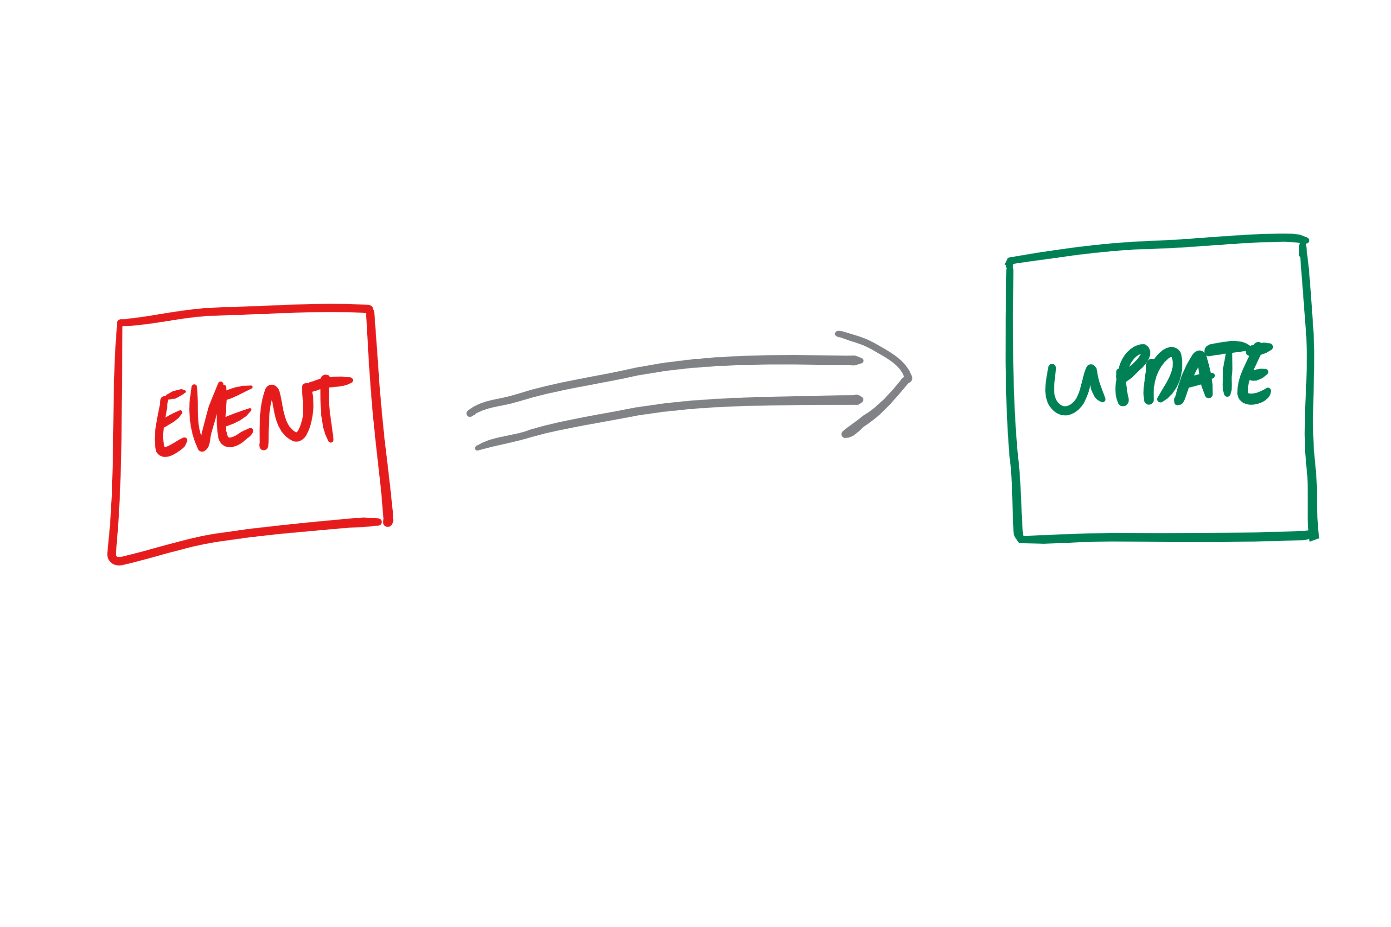
Notes:
And what is worse is not only do we think about things in this way as we talk to the Domain experts using these terms we convince them to think like this to. And that’s just not how things are in the real world
In the real world these systems are being used to record a series of events
13

Slide 14
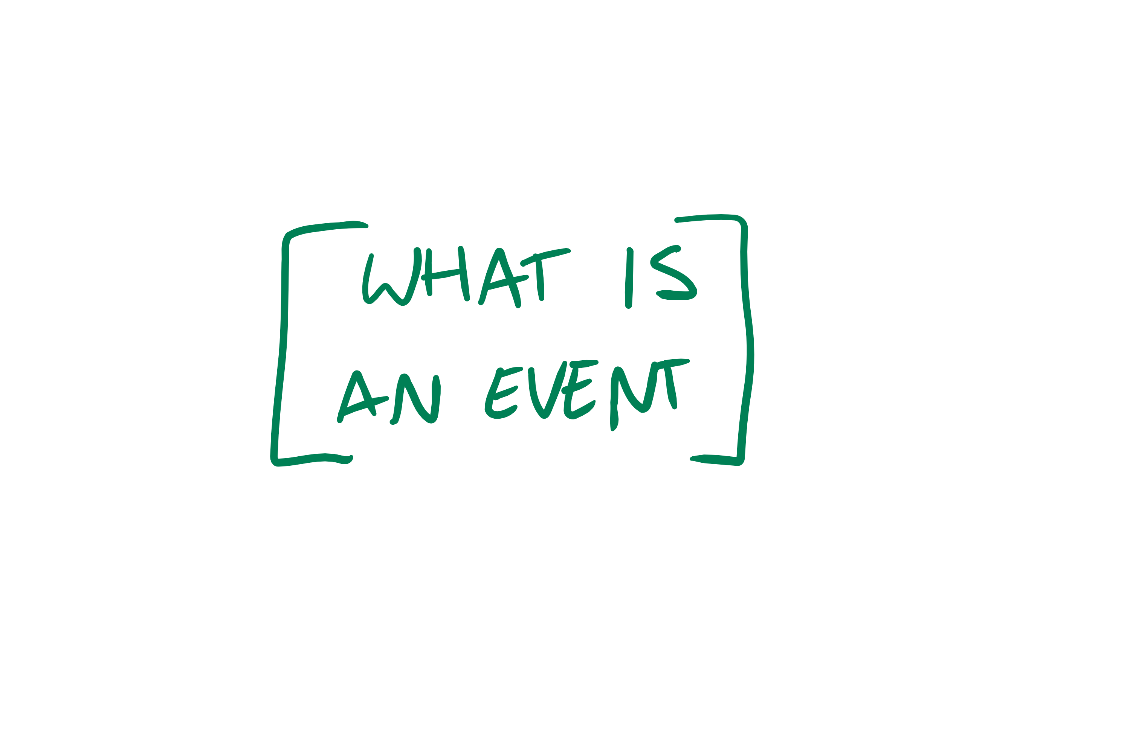
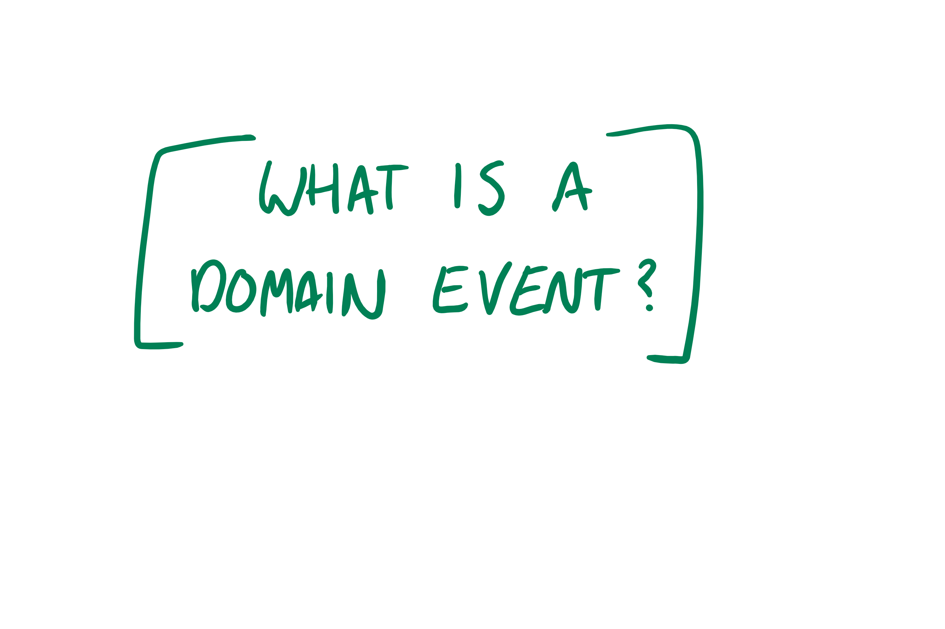

Notes:
So lets now define what is meant by a domain event
Its record of somethign important that happens within your domain,
14

Slide 15
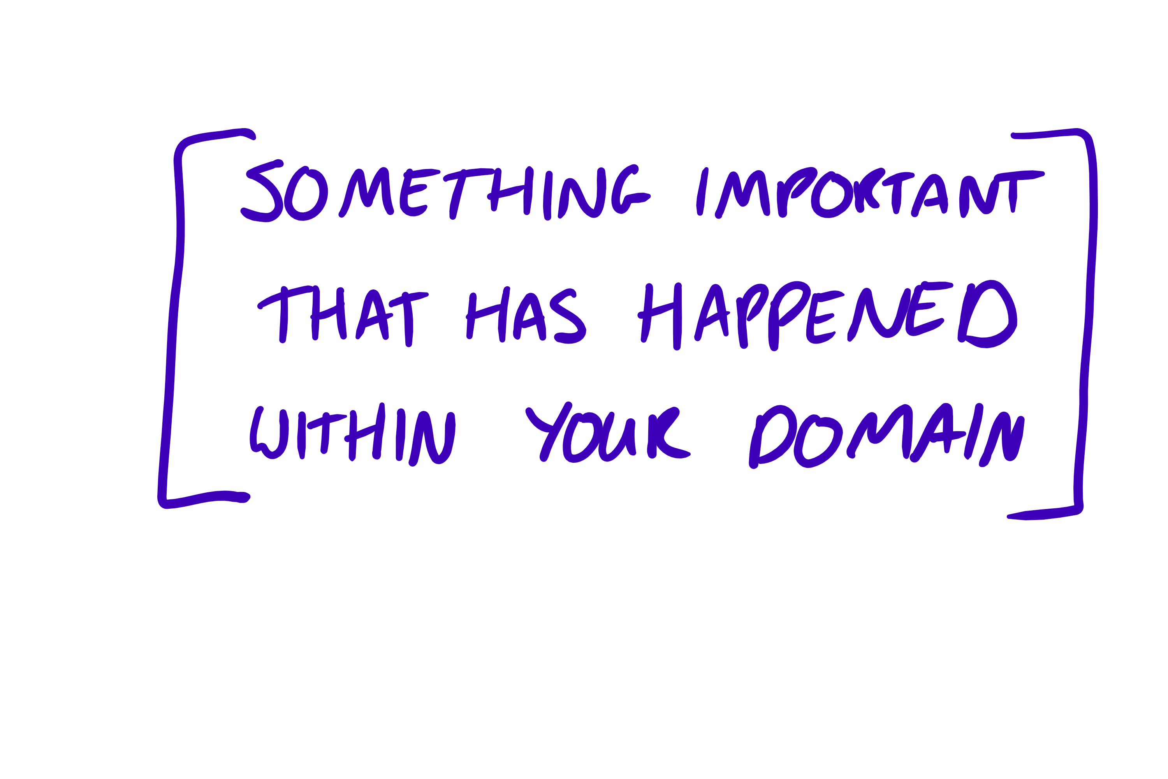

Slide 16
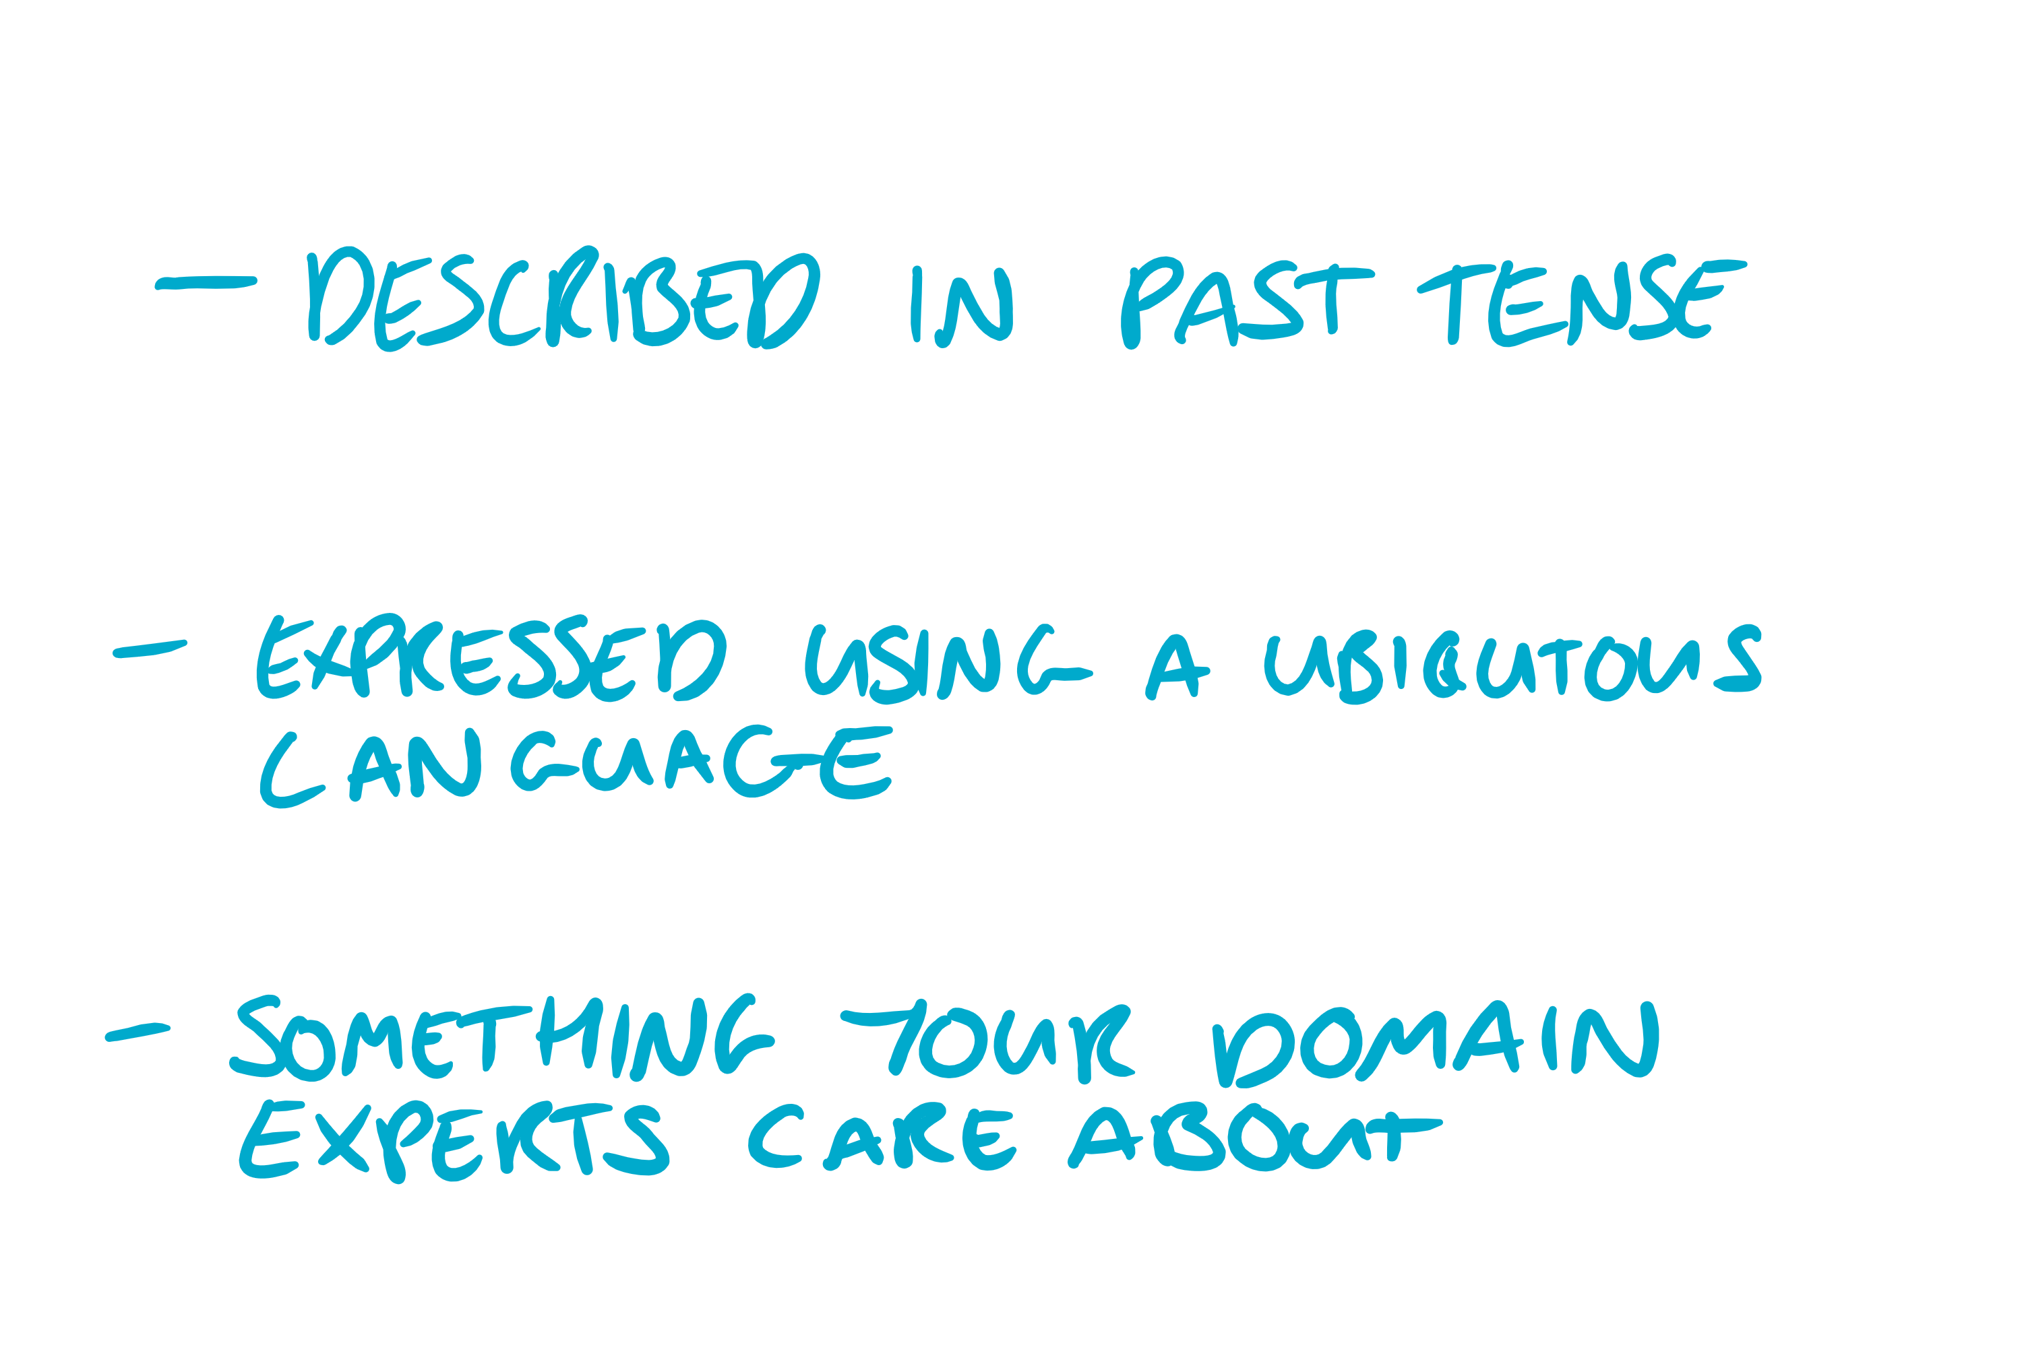
Notes:
Its record of somethign important that happens within your domain,
Event. In this context are things that have happened
The idea behind a ubiquitous language is to create a common language that both you and your domain experts understand
SO some examples of events
And when you move from thinking about updating objects to thinking about the events that happen to them then you perception will completely change
And you start modelling how things happen over time
So how can we use this idea of an event to better understand our domain. To better figure out what our application should be doing
16

Slide 17
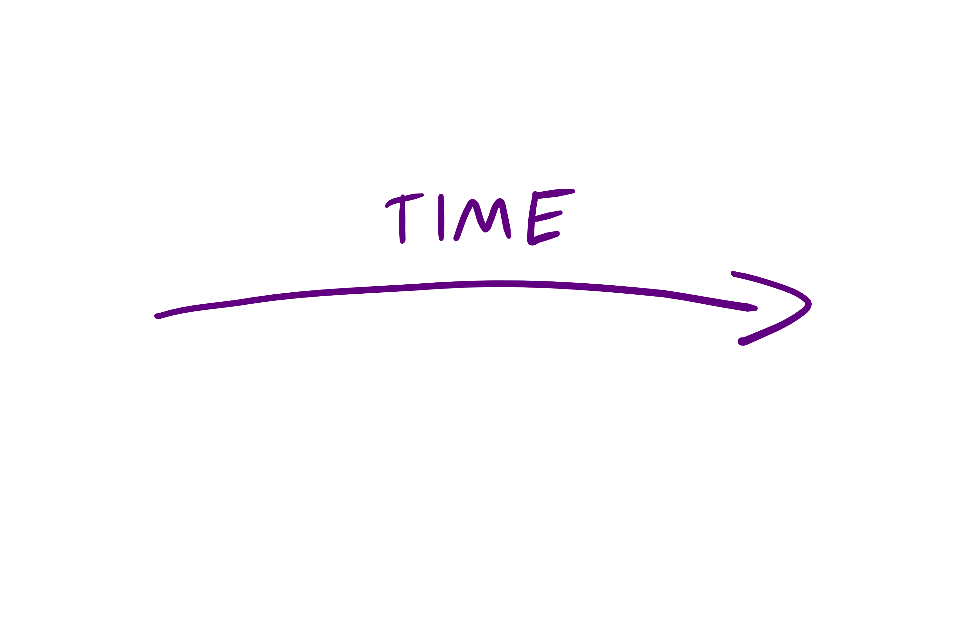

Slide 18
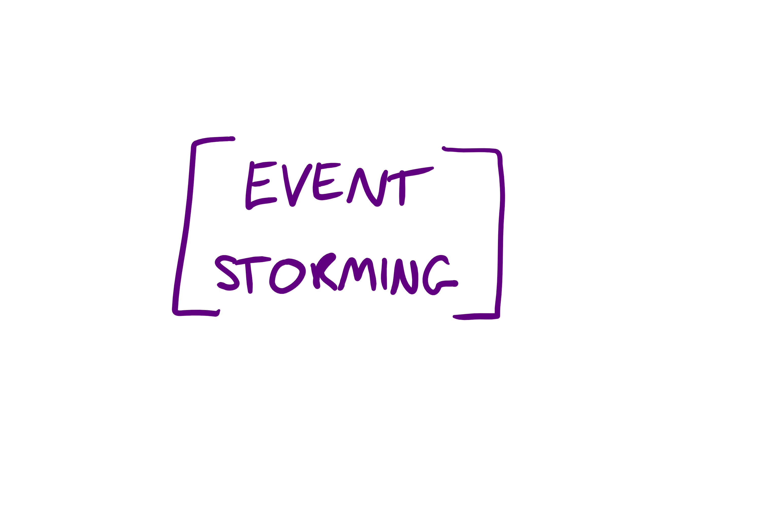
Notes:
It’s a recepie for a collaborative meeting where you and your users want to figure out what the system should be doing
And like any good recepie it needs ingredients
18

Slide 19

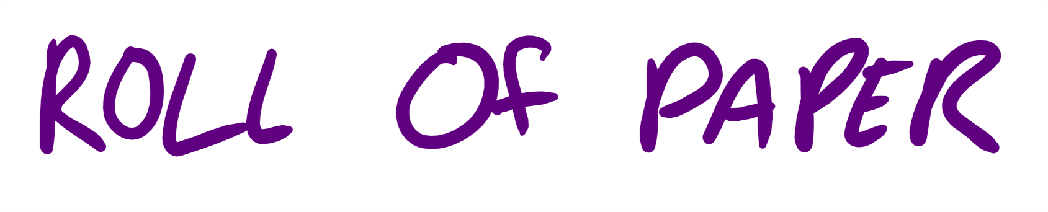
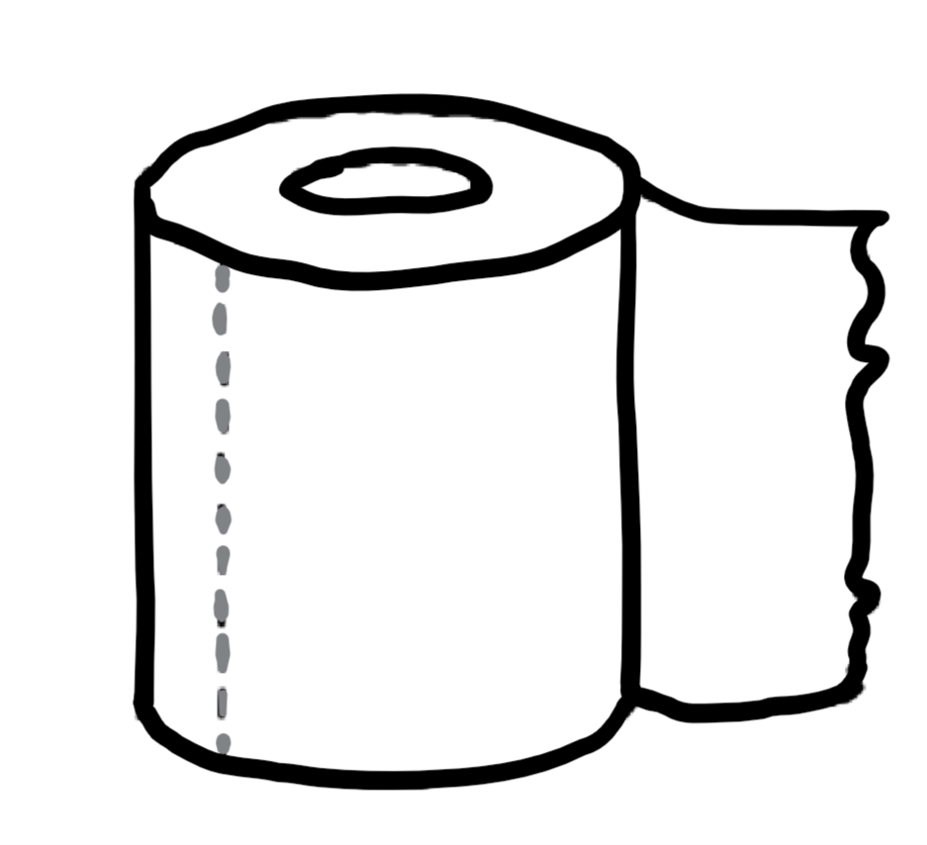

Slide 20
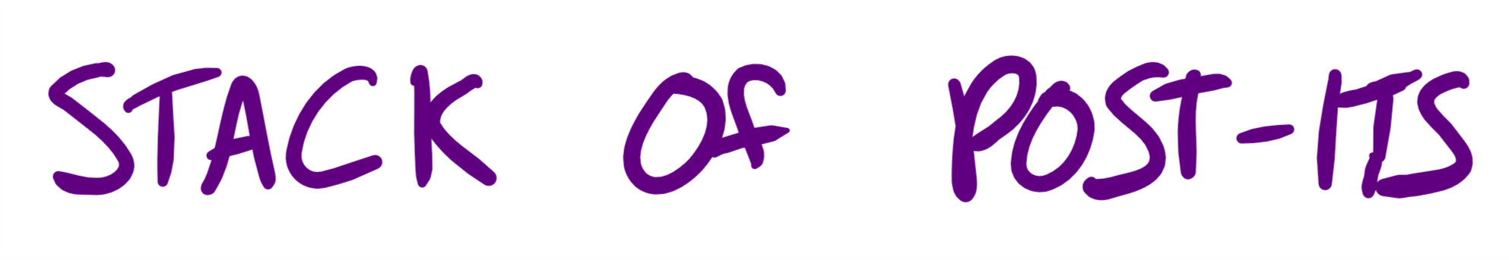



Notes:
Each will have a different meaning alberto specifies certain colours
20

Slide 21
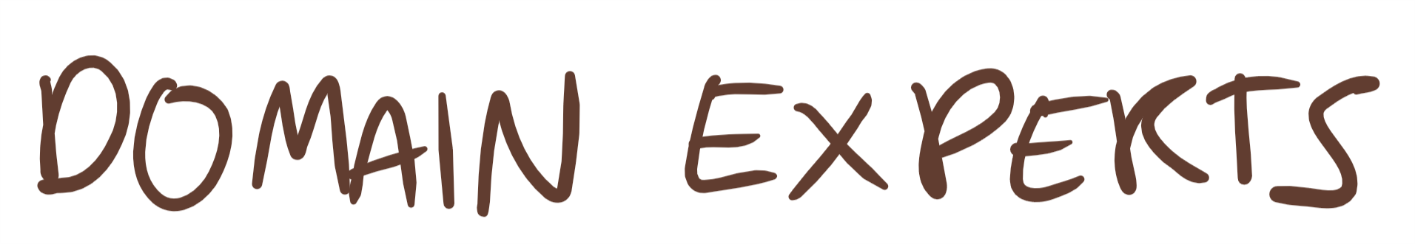

Notes:
Collaborative
Have to have the right people in the room, devs, domain experts
If there is one guy who knows the system and he’s not in the room this will be a pointless exercices
Doesn’t need to be everyone
21

Slide 22
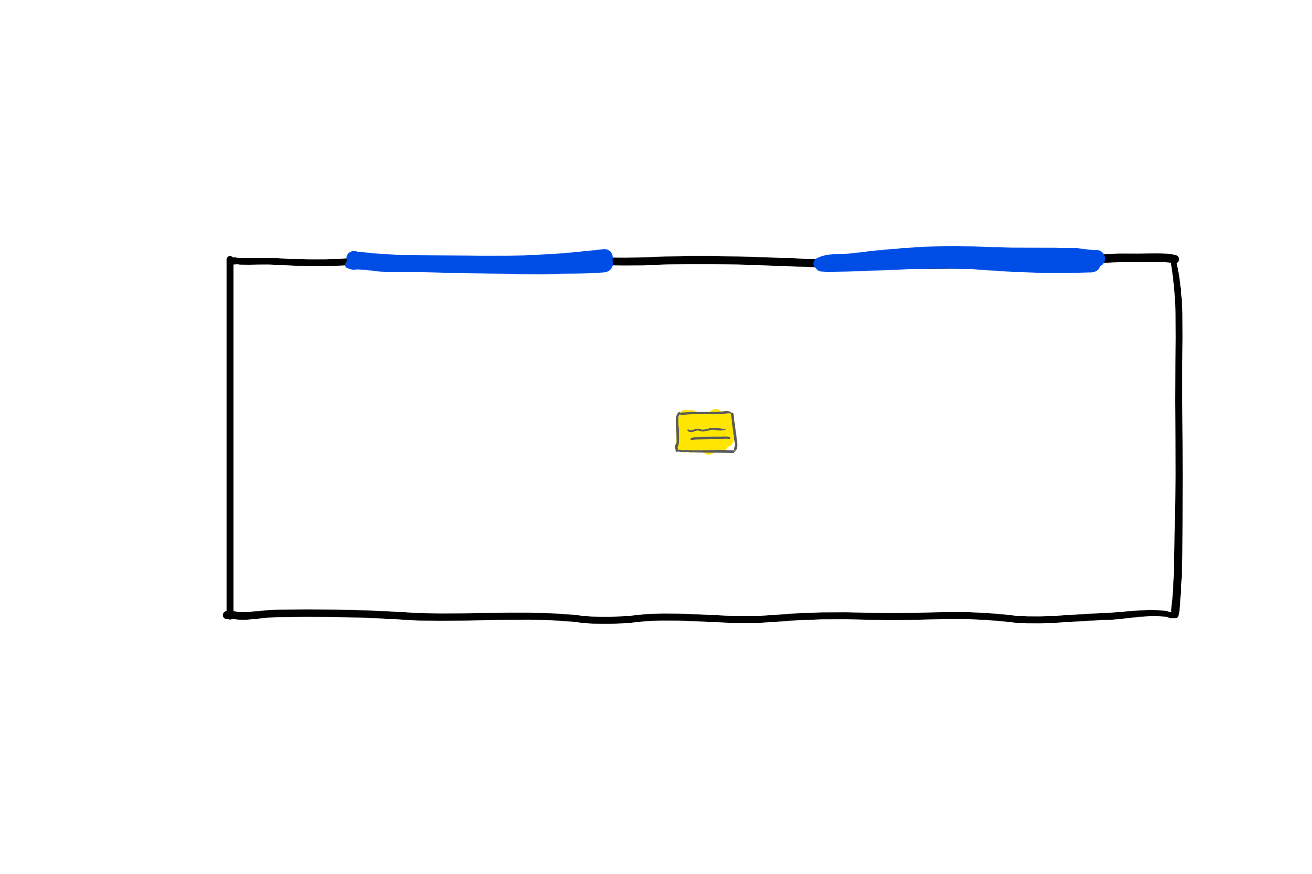
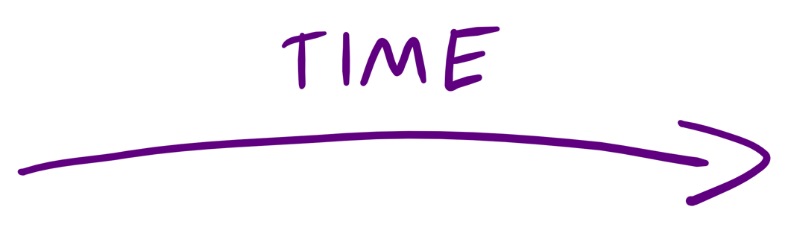


Slide 23
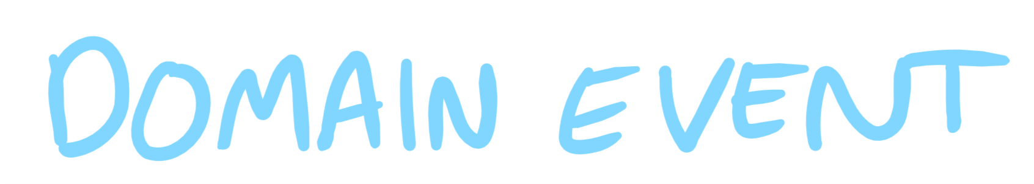

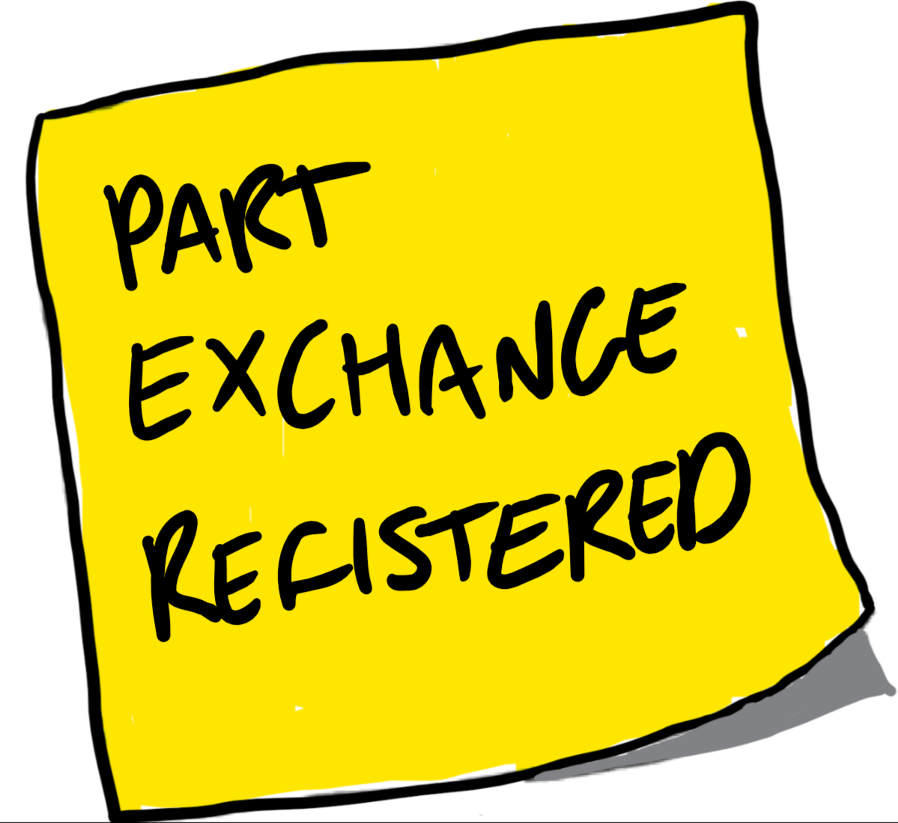



Slide 25


Slide 26
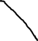

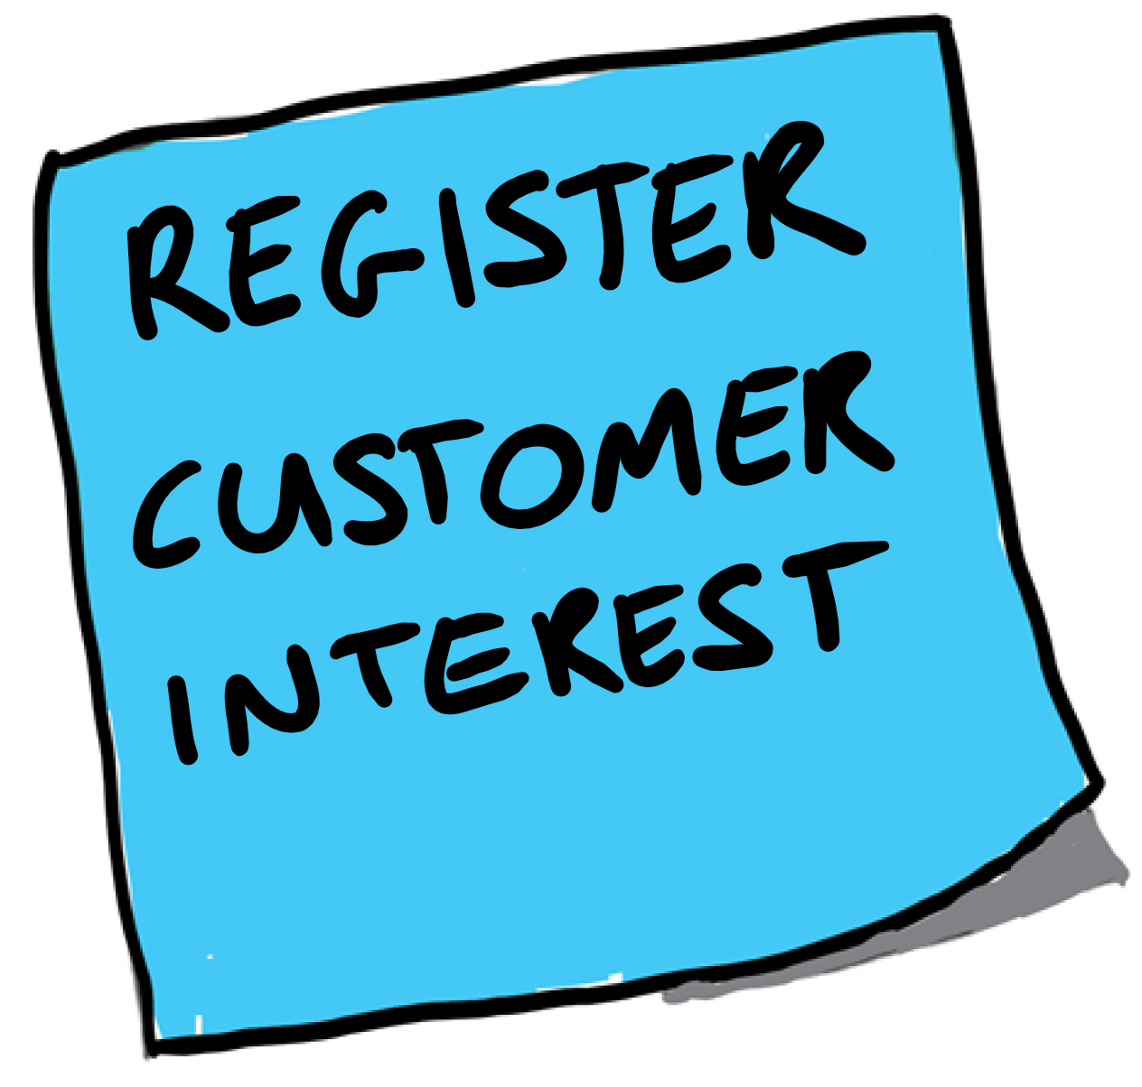

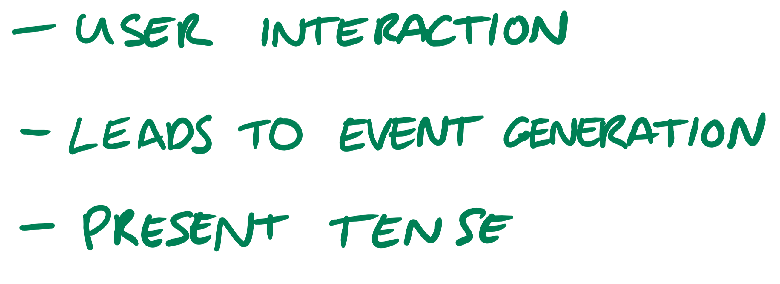
Notes:
Give examples
26

Slide 27
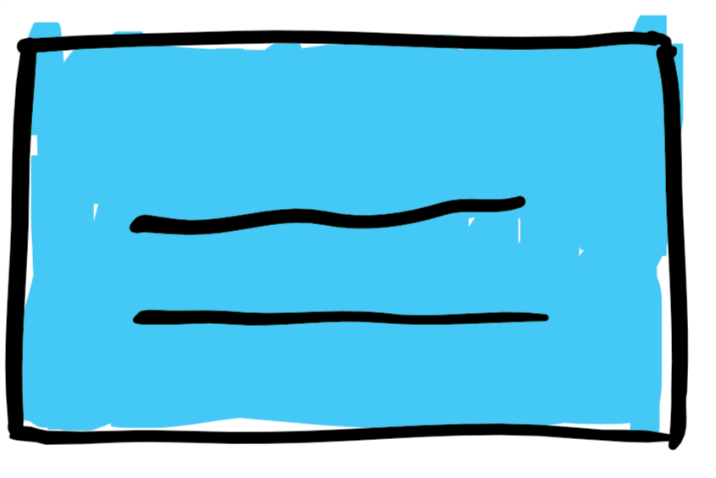

Slide 28
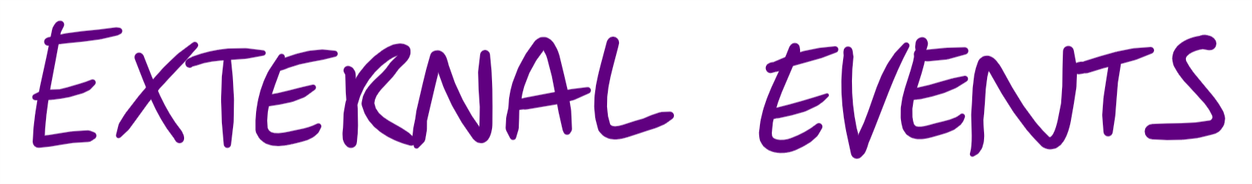
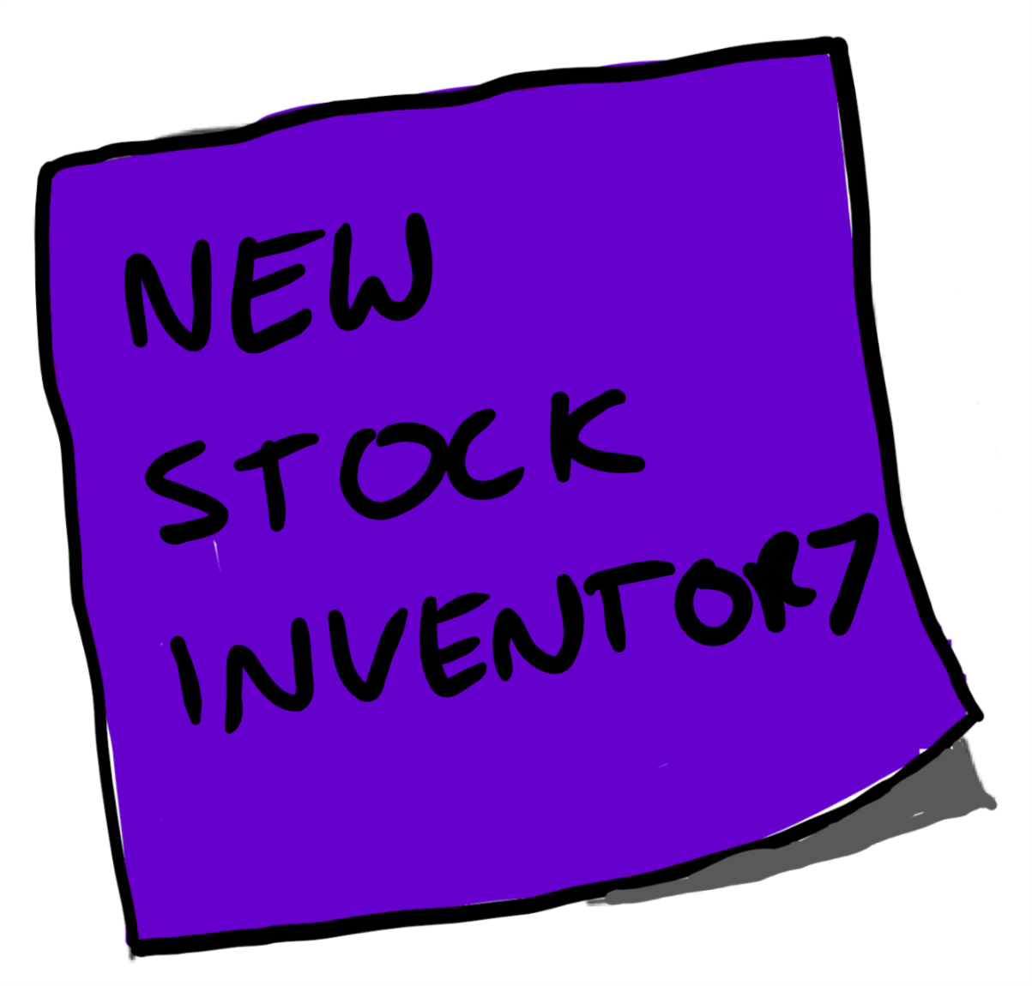


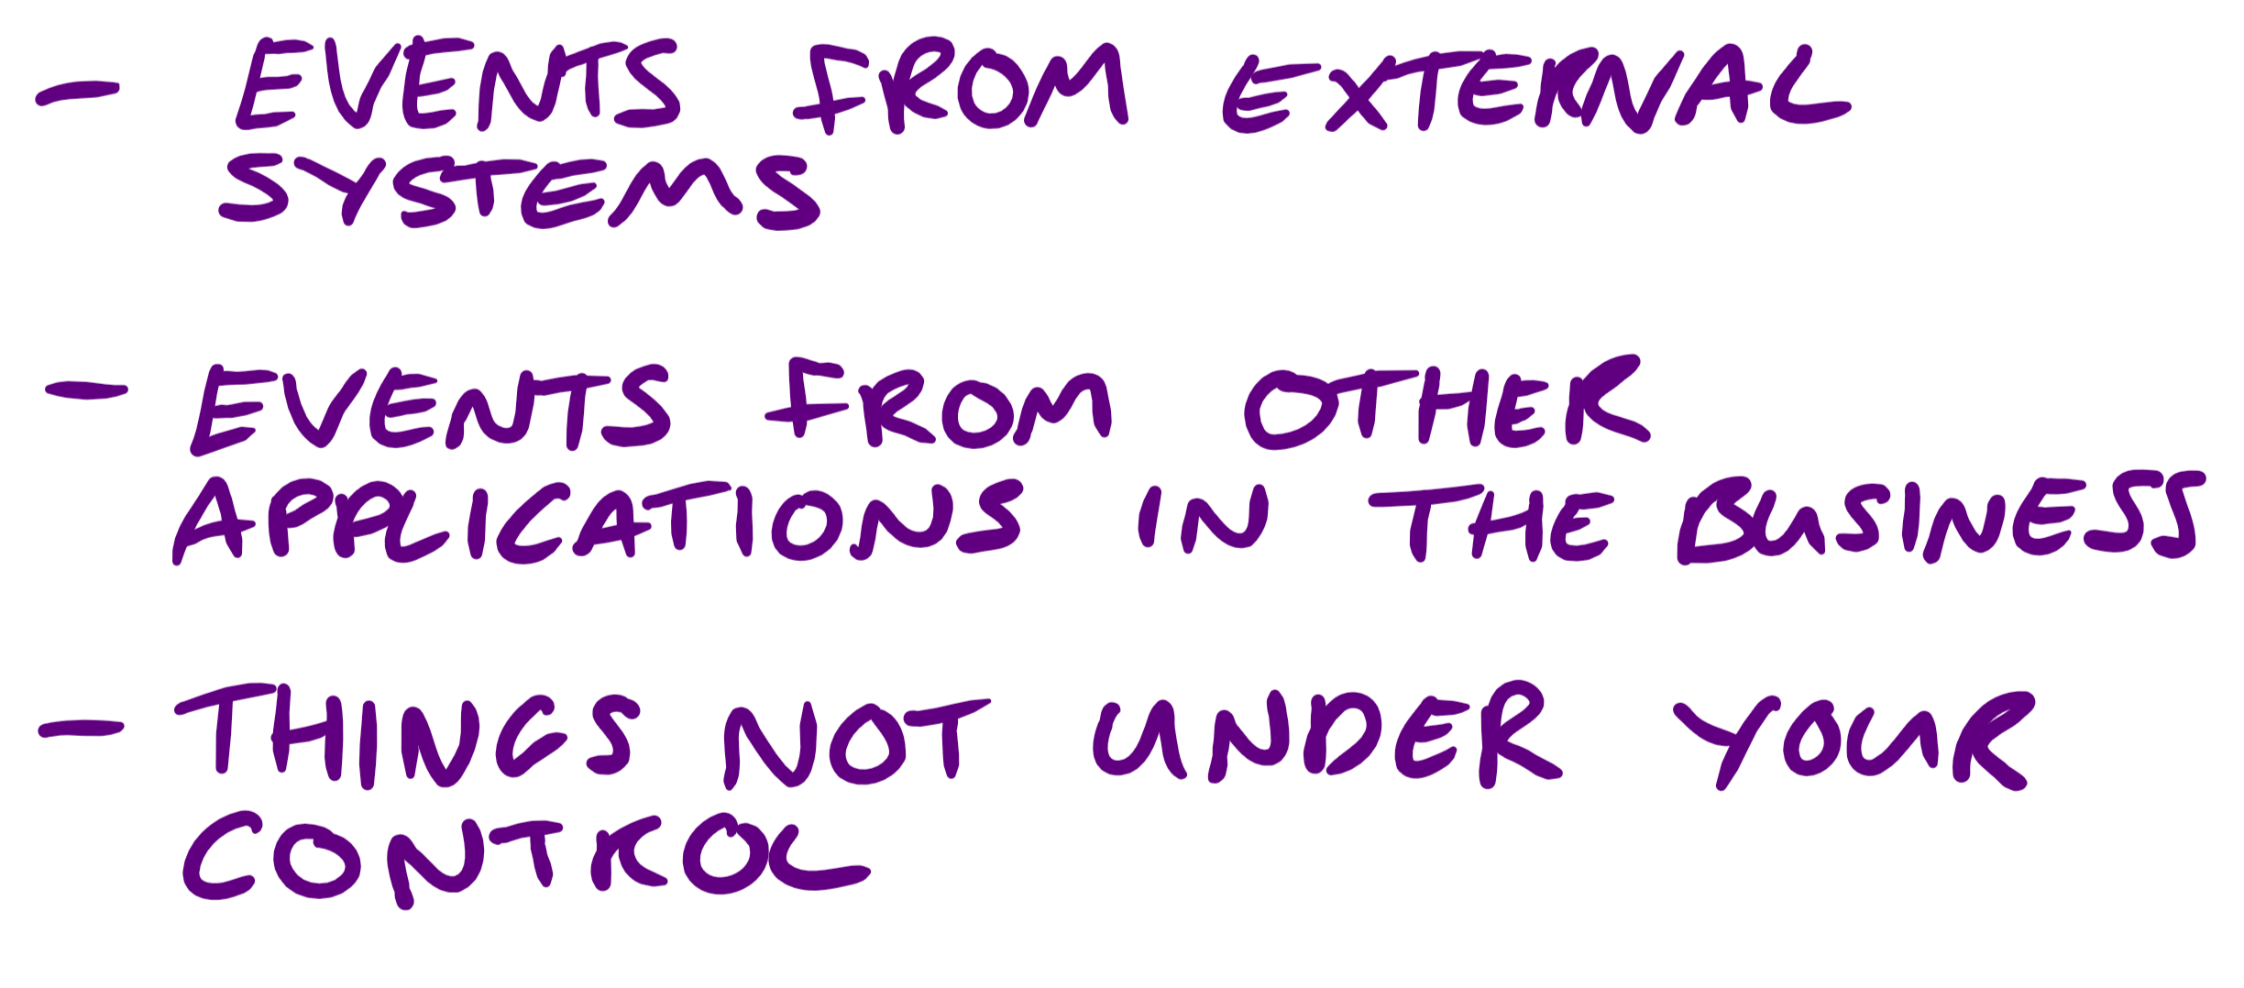

Slide 29
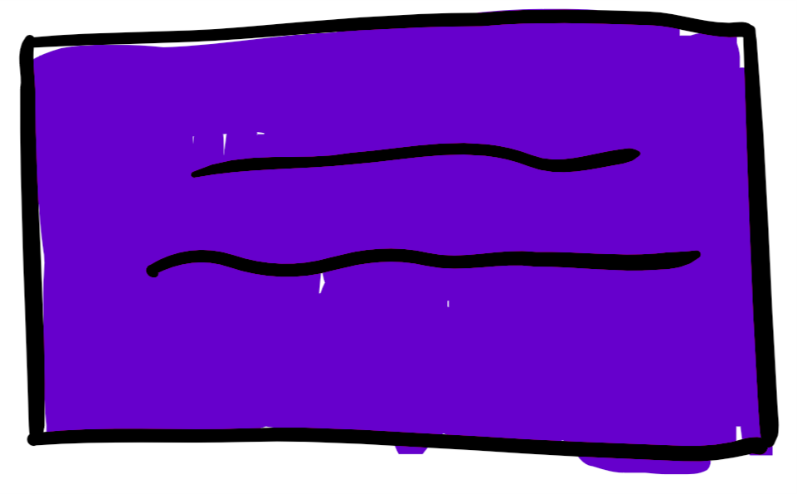
Notes:
You start to get this flow of how the system works
29

Slide 30

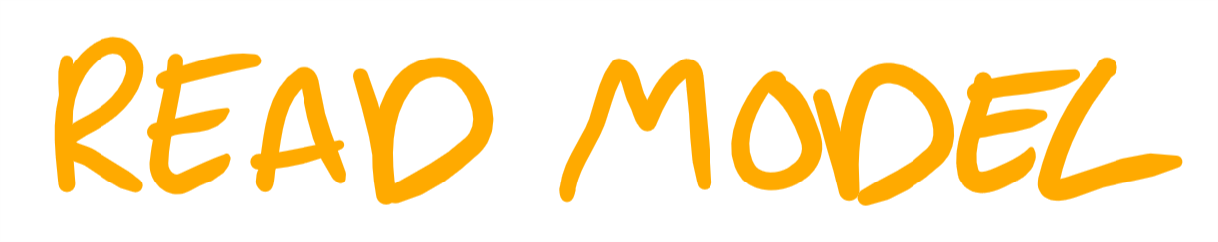

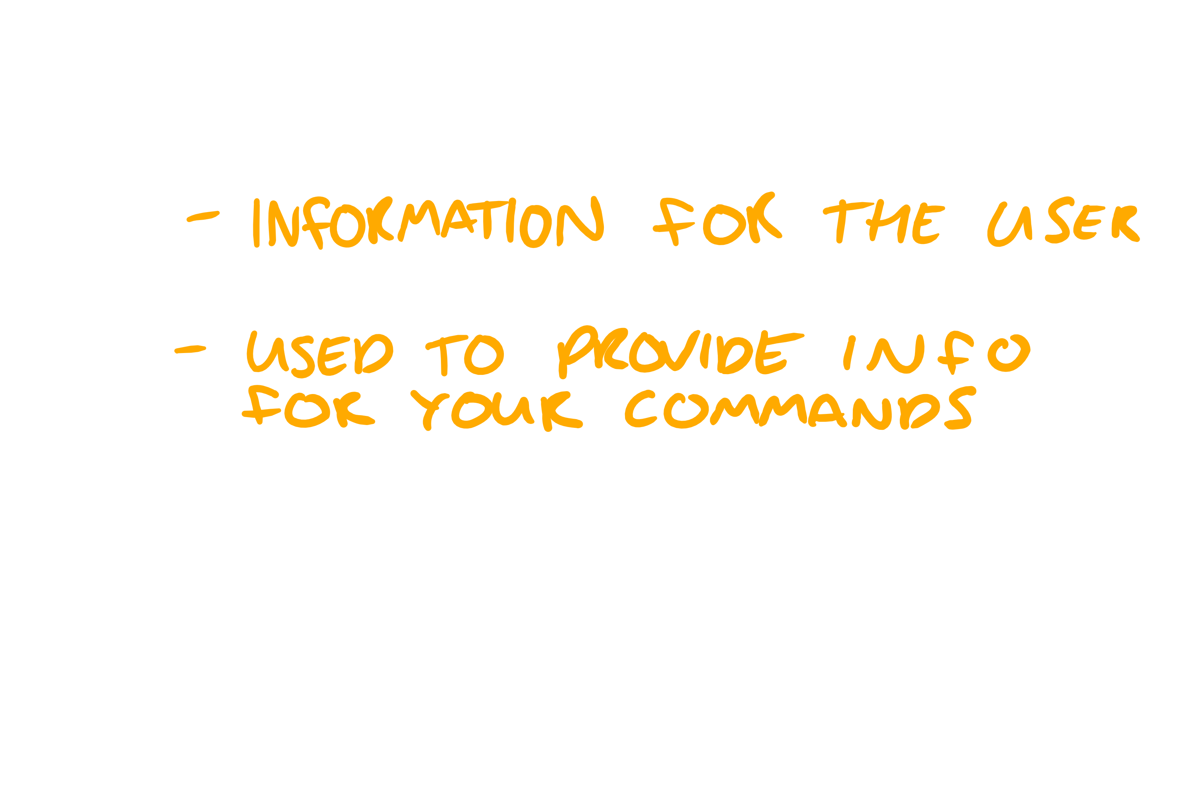
Notes:
Later on you’ll see how events are used to generate the read models
Colours aren’t mandated inthink I’ve used the same as Alberto
30

Slide 31
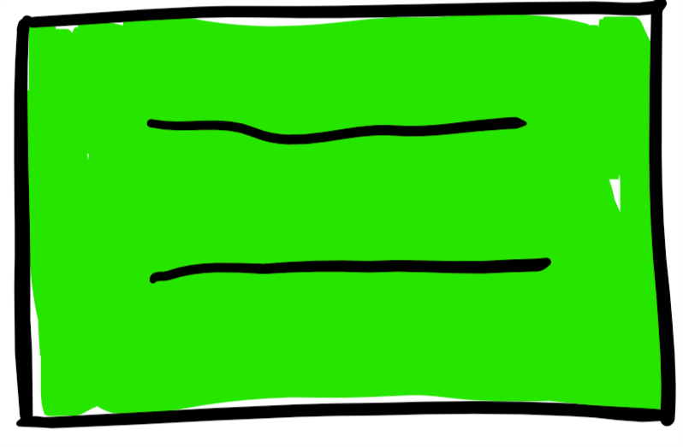

Slide 32
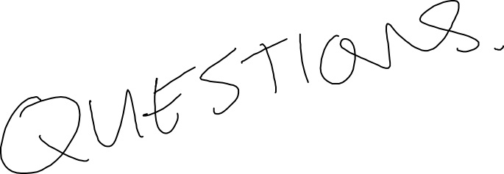
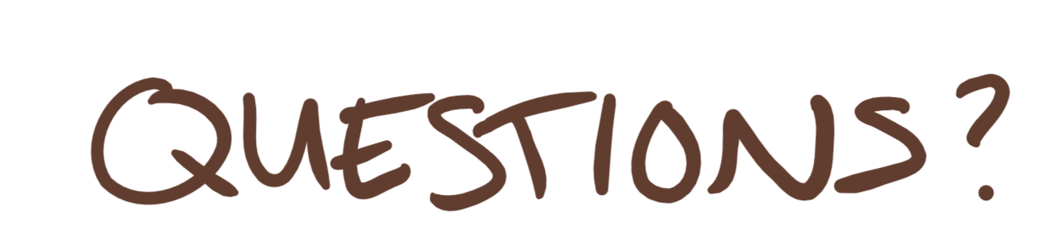
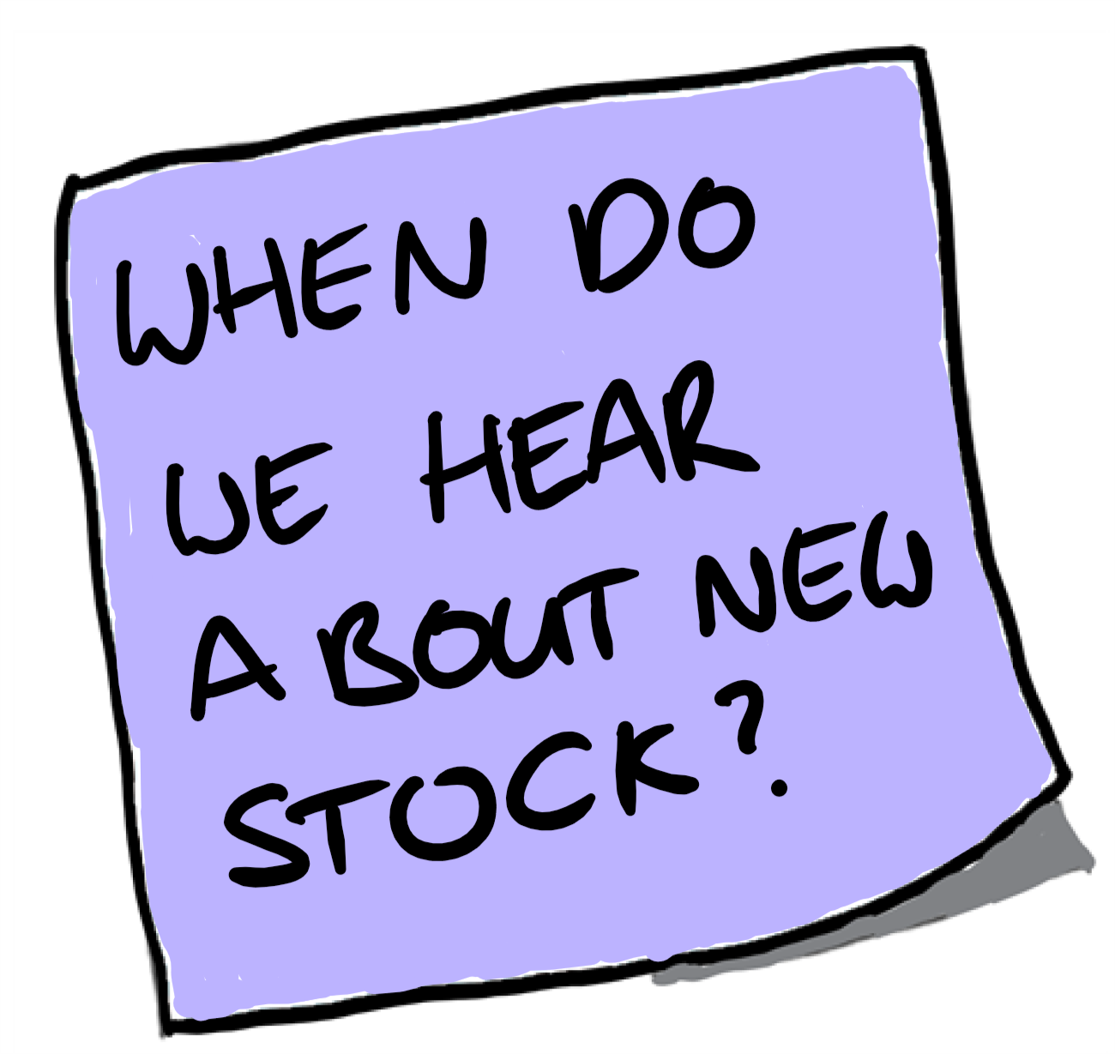
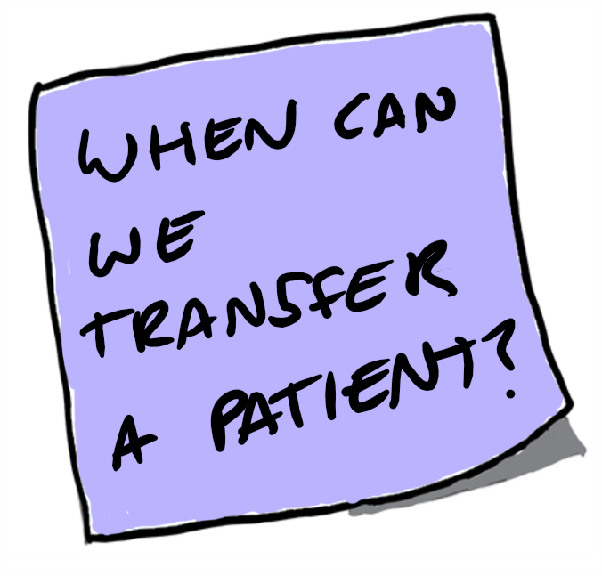
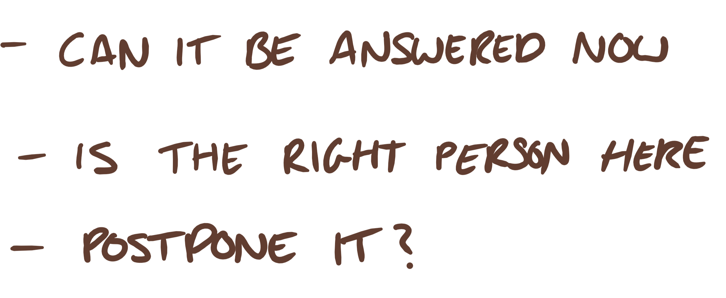
Notes:
Is the right person in the room or leave till later
You might not have all the relevant information
32

Slide 33

Notes:
The great thing about using purple is you can quickly see where the troublesome points are within your system

Slide 34
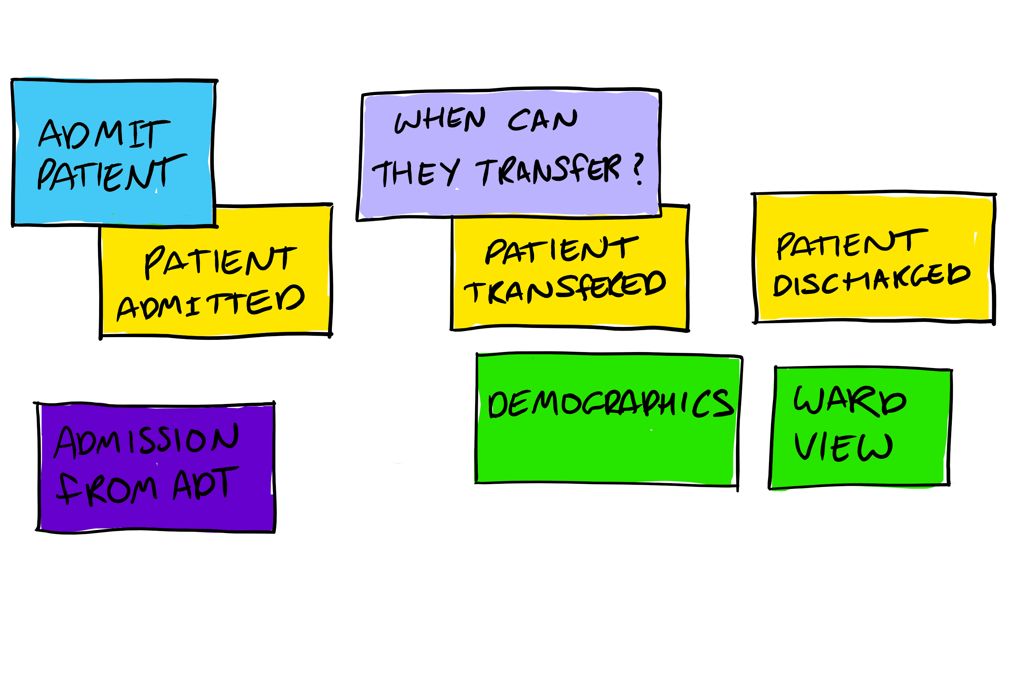
Notes:
More concrete example
Going back to the nhs example
34

Slide 35

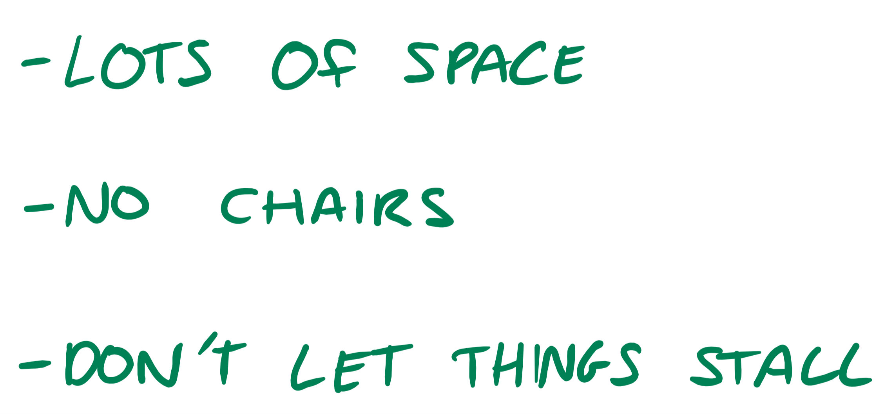
Notes:
35

Slide 36
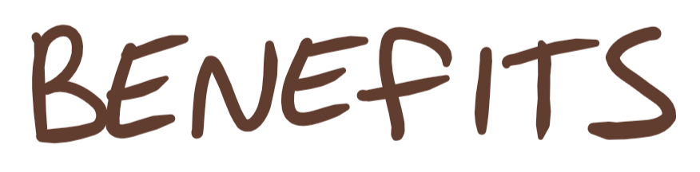
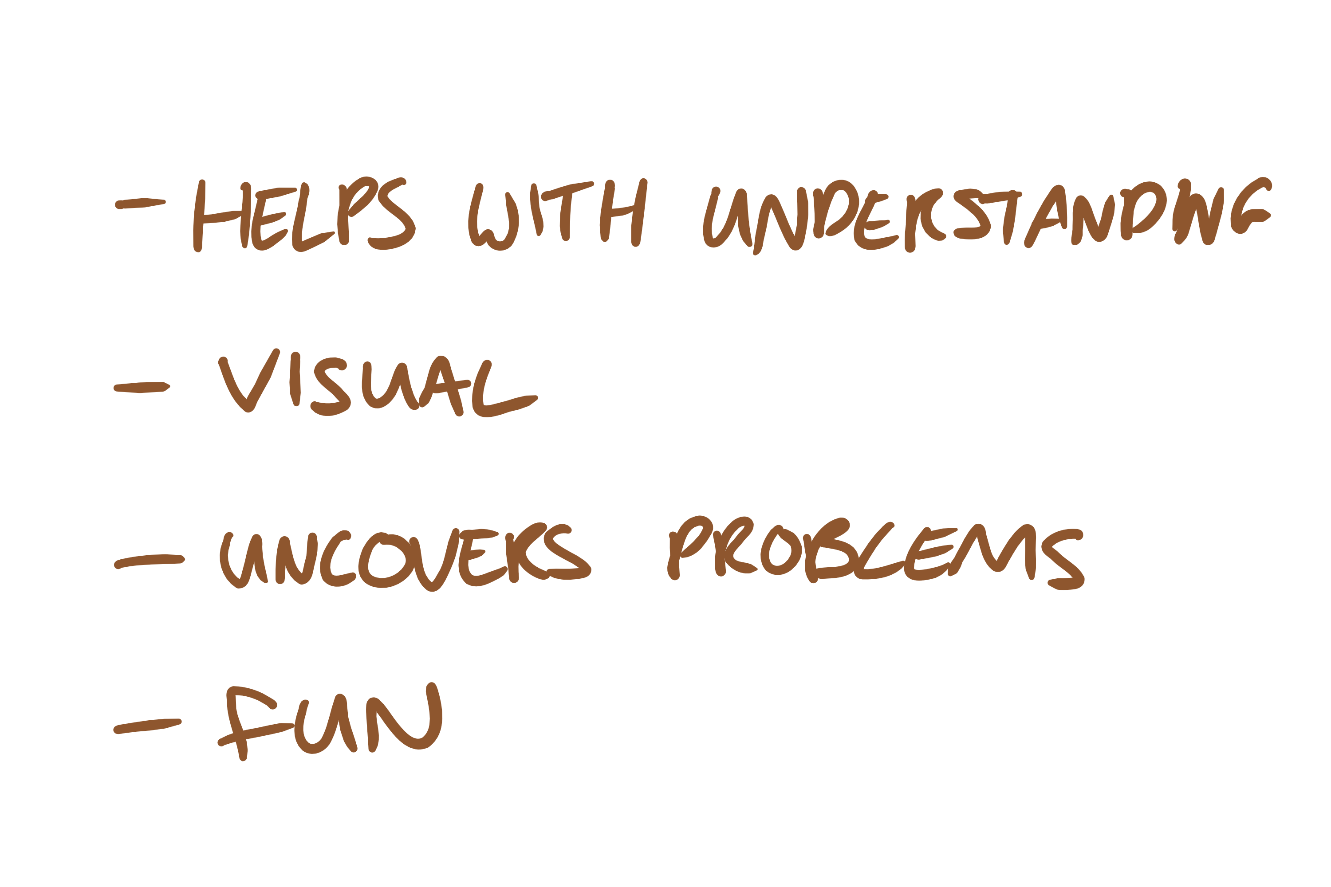
Notes:
Its very visual. Not doing some waterfall BS
Talk about dan
-fun help to engage your domain experts
36

Slide 37
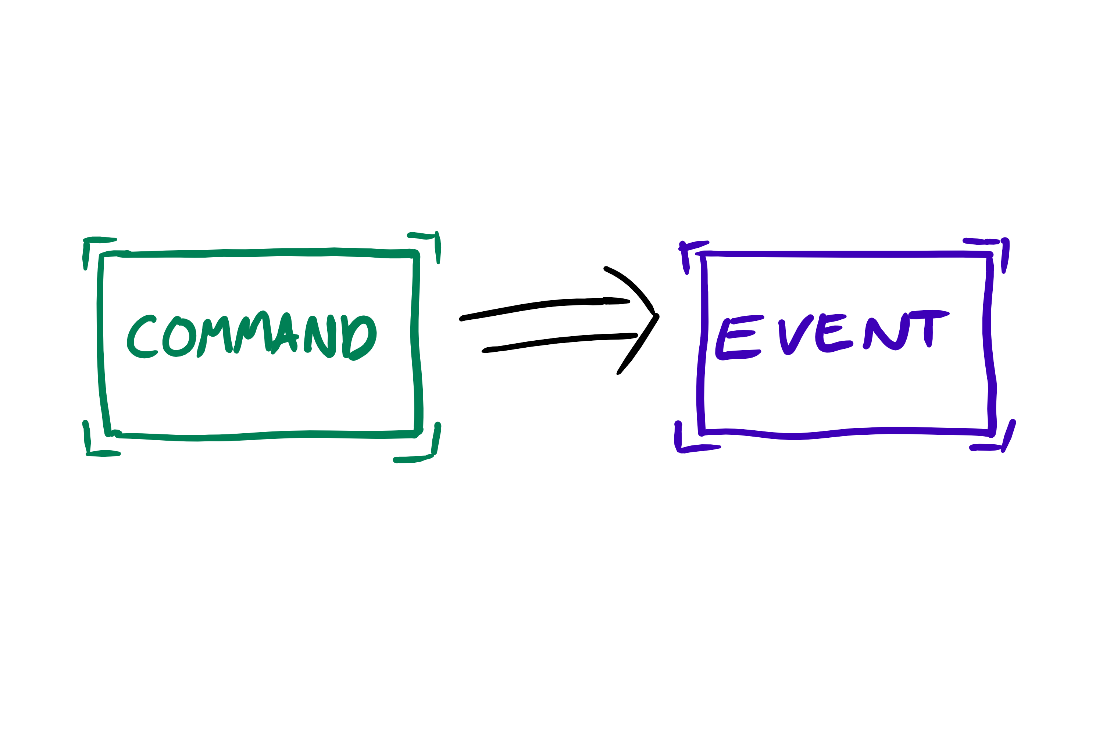
Notes:
37

Slide 38
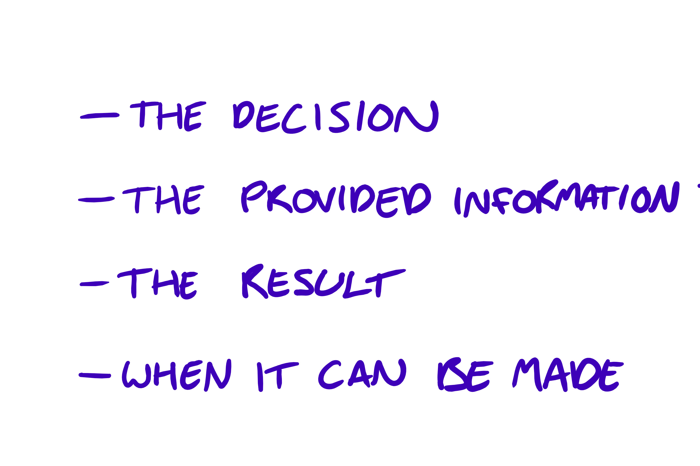

Slide 39

Notes:
Lets talk about how we can use this in code
39

Slide 40

Event Sourcing
Notes:
From greg young
Been around for ages
It’s a different way of persisting your data
40

Slide 41










Patient
Id: 04e3b534-8a4…
Name: Tony Ferguson
Age: 32
Ward: 15
IsAdmitted: true
Patient
Id: 04e3b534-8a40-4180-a7ed-d5afaa45a858
Name: Tony Ferguson
Age: 32
Ward: 10
IsAdmitted: true
AdmitPatientToHosptial()
Patient
Id: 04e3b534-8a40-4180-a7ed-d5afaa45a858
Name: Tony Ferguson
Age: 32
Ward: 76
IsAdmitted: true
TransferPatientToNewWard()
Patient
Id: 04e3b534-8a40-4180-a7ed-d5afaa45a858
Name: Tony Ferguson
Age: 32
Ward: 34
IsAdmitted: true
TransferPatientToNewWard()
Patient
Id: 04e3b534-8a40-4180-a7ed-d5afaa45a858
Name: Tony Ferguson
Age: 32
Ward: null
IsAdmitted: false
DischargePatient()
Patient
Id: 04e3b534-8a4…
Name: Tony Ferguson
Age: 32
Ward: 15
IsAdmitted: true
Patient
Id: 04e3b534-8a4…
Name: Tony Ferguson
Age: 32
Ward: 15
IsAdmitted: true
Patient
Id: 04e3b534-8a40-4180-a7ed-d5afaa45a858
Name: Tony Ferguson
Age: 32
Ward: 5
IsAdmitted: true
Patient
Id: 04e3b534-8a40-4180-a7ed-d5afaa45a858
Name: Tony Ferguson
Age: 32
Ward: null
IsAdmitted: false
Notes:
Ends up looking a little something like this
So as you can see each time I execute a command to update the encounter it results in me modify one or more values in the state
Infact you’ll be lucky if you get methods like this. More often than not you’ll end up with a single UpdateEncounter() method that will be responsible for handling all these situations
With event sourcing rather than storing and update the state of the object you store all the events that have happened to that object, in this case the encounter
WHEN WAS IT WE WERE ONLY ALLOWED TO USE THOSE VERSBS
41

Slide 42

Patient
Id: 04e3b534-8a4…
Name: Tony Ferguson
Age: 32
Ward: 15
IsAdmitted: true
Patient
Id: 04e3b534-8a4…
Name: Tony Ferguson
Age: 32
Ward: 15
IsAdmitted: true
Patient
Id: 04e3b534-8a40-4180-a7ed-d5afaa45a858
Name: Tony Ferguson
Age: 32
Ward: 10
IsAdmitted: true
PatientAdmitted
Id: 04e3b534-8a40-41…
Name: Tony Ferguson
Age: 32
Ward: 10
AdmitPatientToHosptial()
Patient
Id: 04e3b534-8a40-4180-a7ed-d5afaa45a858
Name: Tony Ferguson
Age: 32
Ward: 76
IsAdmitted: true
PatientTransferred
Id: 04e3b534-8a40-41…
ToWard: 76
TransferPatientToNewWard()
Patient
Id: 04e3b534-8a40-4180-a7ed-d5afaa45a858
Name: Tony Ferguson
Age: 32
Ward: 34
IsAdmitted: true
PatientTransferred
Id: 04e3b534-8a40-41…
ToWard: 34
TransferPatientToNewWard()
PatientDischarged
Id: 04e3b534-8a4a…
Patient
Id: 04e3b534-8a40-4180-a7ed-d5afaa45a858
Name: Tony Ferguson
Age: 32
Ward: null
IsAdmitted: false
DischargePatient()
Patient
Id: 04e3b534-8a4…
Name: Tony Ferguson
Age: 32
Ward: 15
IsAdmitted: true
Patient
Id: 04e3b534-8a40-4180-a7ed-d5afaa45a858
Name: Tony Ferguson
Age: 32
Ward: 5
IsAdmitted: true
Patient
Id: 04e3b534-8a40-4180-a7ed-d5afaa45a858
Name: Tony Ferguson
Age: 32
Ward: null
IsAdmitted: false
Notes:
42

Slide 43

Notes:
Why would you want to go to this effort
43

Slide 44

Notes:
Well consider this. In the first example where you are just saving state. You’ll only ever know the current ward the patient is on.
These two transfers will be lost. You’d never know that the patient was on wards 15 and 5?
Infact you could know. Because you could create an audit log of the encounter table right? Maybe set up a trigger that copies out the row before it gets updated? I bet we’ve all done this right? I know I have
44

Slide 45





Slide showing row in the a table and audit table belwo
04e3b534-8a40…
Tony Ferguson
32
NULL
false
34
04e3b534-8a40…
Tony Ferguson
32
true
04e3b534-8a40…
Tony Ferguson
32
76
true
04e3b534-8a40…
Tony Ferguson
32
10
true
Notes:
But this is bad for a number of reasons.
You often end up auditing out the state. Which means you need to store a lot of information and at a later point actually go to the effort of figuring out what changed
Also you have no record of why the record changed. If you log out the events then you actually have the intent as well. Which belive you me is pretty important if you ever come to being audited.
Finally how can you be sure your audit log is event right if you are using it as a secondary after thought? With event sourcing you are doing it first and your are using it as your primary source of truth with in the system. So you’ll always know it to be correct.
So how does this work in practice? Its one thing saying you have all these events but how does that work. How does this change the way you write you code and interact with your object?
MULTIPLE OTHER REASONS WHY YOU@D WANT TO THINK ABOUT YOUR SYSTEM IN EVENTS
45

Slide 46




PatientAdmitted
Notes:
Well it all ends up looking a little something like this.
If we take the encounter object that we looked at earlier
When we first admit the patient to the hospital we generate a Patient admitted event from the back of this command
When we then want to transfer the patient. Well the first thing we need to do is find out if they have been admitted first. So we retrieve and replay the Patient admitted event against the encounter to make sure its in the right state to execute the command. If that’s successful then we take that event and persist it along with the first one.
Then when we need to transfer the patient again we have two events that we have to retrieve and replay to put the transfer object in the same state
And then again the same principle with being discharged replay the first 3 events and then apply the next
And eventually you’ll end up with a long stream of events of everthing that has happened to this object.
Now this is great but it does have some downsides one of the most obvious being the over heard of having to retrieve the events and rehydrate the object. Compared to a simple read this can quite expensive. There are a number of techniques to help deal with this such as snapshotting or the memento pattern that I’m not going to discuss those today. What I am going to discuss though is CQRS
46

Slide 47

Notes:
This works for a single object really well but it doesn’t work aggregations of data
47

Slide 48

CQRS
Notes:
Turns out it works event sourcing works really well in generating these views
48

Slide 49
PatientAdmitted
Id: 04e3b534-8a40-41…
Name: Tony Ferguson
Age: 32
Ward: 10
PatientTransferred
Id: 04e3b534-8a40-41…
ToWard: 76
PatientTransferred
Id: 04e3b534-8a40-41…
ToWard: 34
PatientDischarged
Id: 04e3b534-8a4a…
Notes:
Where each event translates into a database insert update or delete query on the a view that can be used for reading from later often called a projection
This is one of the huge advantages you can gain out of event sourcing. By using the events generated from they system you can use them to generate a view that is ideal for reading.
For example in this case my view is designed to show me all the patients that are currently admitted into the hospital and tell me what ward they are currently on. I don’t care about the patients after they have been discharged so I can delete them.
Also what happens if I make a mistake with my view, perhaps there is a bug. Well its incredibly easy to fix now because I can just fix my update that reacts to the patient transferred event delete the view and then replay all the events in the system and my view will be regenerated.
What other advantages does it bring? What if my boss says he wants to see who was on the wards 10 days ago. Well then you could just replay all the events until 10 days ago and there you go.
So what else can we do? Well when you start to think about it. Once you have generated one projection, one view, why can’t you create more? Why can’t you create a view that is specific to every part of the system? Well you can
49

Slide 50



PatientAdmitted
Id: 04e3b534-8a40-41…
Name: Tony Ferguson
Age: 32
Ward: 10
PatientTransferred
Id: 04e3b534-8a40-41…
ToWard: 76
04e3b534-8a40…
Tony Ferguson
32
34
PatientTransferred
Id: 04e3b534-8a40-41…
ToWard: 34
PatientDischarged
Id: 04e3b534-8a4a…
Notes:
Where each event translates into a database insert update or delete query on the a view that can be used for reading from later often called a projection
This is one of the huge advantages you can gain out of event sourcing. By using the events generated from they system you can use them to generate a view that is ideal for reading.
For example in this case my view is designed to show me all the patients that are currently admitted into the hospital and tell me what ward they are currently on. I don’t care about the patients after they have been discharged so I can delete them.
Also what happens if I make a mistake with my view, perhaps there is a bug. Well its incredibly easy to fix now because I can just fix my update that reacts to the patient transferred event delete the view and then replay all the events in the system and my view will be regenerated.
What other advantages does it bring? What if my boss says he wants to see who was on the wards 10 days ago. Well then you could just replay all the events until 10 days ago and there you go.
So what else can we do? Well when you start to think about it. Once you have generated one projection, one view, why can’t you create more? Why can’t you create a view that is specific to every part of the system? Well you can
50

Slide 51


PatientAdmitted
Id: 04e3b534-8a40-41…
Name: Tony Ferguson
Age: 32
Ward: 10
PatientTransferred
Id: 04e3b534-8a40-41…
ToWard: 76
04e3b534-8a40…
Tony Ferguson
32
76
PatientTransferred
Id: 04e3b534-8a40-41…
ToWard: 34
PatientDischarged
Id: 04e3b534-8a4a…
Notes:
Where each event translates into a database insert update or delete query on the a view that can be used for reading from later often called a projection
This is one of the huge advantages you can gain out of event sourcing. By using the events generated from they system you can use them to generate a view that is ideal for reading.
For example in this case my view is designed to show me all the patients that are currently admitted into the hospital and tell me what ward they are currently on. I don’t care about the patients after they have been discharged so I can delete them.
Also what happens if I make a mistake with my view, perhaps there is a bug. Well its incredibly easy to fix now because I can just fix my update that reacts to the patient transferred event delete the view and then replay all the events in the system and my view will be regenerated.
What other advantages does it bring? What if my boss says he wants to see who was on the wards 10 days ago. Well then you could just replay all the events until 10 days ago and there you go.
So what else can we do? Well when you start to think about it. Once you have generated one projection, one view, why can’t you create more? Why can’t you create a view that is specific to every part of the system? Well you can
51

Slide 52
PatientAdmitted
Id: 04e3b534-8a40-41…
Name: Tony Ferguson
Age: 32
Ward: 10
PatientTransferred
Id: 04e3b534-8a40-41…
ToWard: 76
04e3b534-8a40…
Tony Ferguson
32
34
PatientTransferred
Id: 04e3b534-8a40-41…
ToWard: 34
PatientDischarged
Id: 04e3b534-8a4a…
Notes:
Where each event translates into a database insert update or delete query on the a view that can be used for reading from later often called a projection
This is one of the huge advantages you can gain out of event sourcing. By using the events generated from they system you can use them to generate a view that is ideal for reading.
For example in this case my view is designed to show me all the patients that are currently admitted into the hospital and tell me what ward they are currently on. I don’t care about the patients after they have been discharged so I can delete them.
Also what happens if I make a mistake with my view, perhaps there is a bug. Well its incredibly easy to fix now because I can just fix my update that reacts to the patient transferred event delete the view and then replay all the events in the system and my view will be regenerated.
What other advantages does it bring? What if my boss says he wants to see who was on the wards 10 days ago. Well then you could just replay all the events until 10 days ago and there you go.
So what else can we do? Well when you start to think about it. Once you have generated one projection, one view, why can’t you create more? Why can’t you create a view that is specific to every part of the system? Well you can
52

Slide 53

PatientAdmitted
Id: 04e3b534-8a40-41…
Name: Tony Ferguson
Age: 32
Ward: 10
PatientTransferred
Id: 04e3b534-8a40-41…
ToWard: 76
PatientTransferred
Id: 04e3b534-8a40-41…
ToWard: 34
PatientDischarged
Id: 04e3b534-8a4a…
Notes:
When you start having a separate read and write theres no reason you can’t take it further and have multiple read models
53

Slide 54

Notes:
So if we have multiple things things listening to a single a event we can easily generate multiple views of the data
You can literally go crazy and build loads. It doesn’t matter if they go out of sync to a certain degree due to a bug. Because as mentioned before you can just rebuild the projection from scratch from a single source of truth. Your event stream
So all these ideas can be put together into an architecture. Its not the only way to build an application like this but many will often end up looking like a derivative of this
INFACT ITS QUIET NICE because YOU CAN BUILD THEM TO ANY POINT IN TIME
54

Slide 55


Notes:
The client hands of a command to the dispatcher which in turn pulls an objet

Slide 56


Slide 57


Notes:
57

Slide 58


Version
List<Events>()

Slide 59


Slide 60



Slide 61

Notes:
Now there is one problem with this architecture and that’s that it can become slow to actuall issue a command
61

Slide 62



Slide 63


Slide 64


Slide 65





Notes:
Where the use interface is more focused on the tasks that need to be completed rather than just updating the object
It can be more context driven where only the commands that are available to you at the time are presesent
And you’ll only end up needing to display the datat that is relevant at the time to. This can lead to a better working application

Slide 66

Notes:
You’ve all seen the given when then testing
66

Slide 67

Notes:
Also easy for domain experts to understand
67

Slide 68

Notes:
Microservices, nano service, sensible sized services
68

Slide 69

Notes:
Talk about difference between http and queues
Advtanges and disadvantages of both
Using message queues mean that if service a puts a message on the queue service b can receive it immediately
http api means that it is control of the events and can pull them from any point in time. But there may be a delay in when it gets them because it needs to poll for them
69

Slide 70

Notes:
70

Slide 71



Slide 72



Slide 73
https://github.com/mat-mcloughlin/PatientMangement

Slide 74



Wrap it up
DDD-ES-CQRS Google Group https://groups.google.com/forum/#!forum/dddcqrs
DDD-ES-CQRS Slack Channel http://ddd-cqrs-es.herokuapp.com/
Greg Young, Event Sourcing https://www.youtube.com/watch?v=JHGkaShoyNs
Notes:
And that’s pretty much.
I really have only shown you the basic happy path when it comes to building applications in this fashion. The tip of the iceberg. So there is lots more to learn but there are some great resources out there.
74

